Slide 1
HSBCnet Payments

Slide 2
Topic Covered
INTRODUCTION
NEED OF THE TOOL
BASIC NEEDS
ENTITLEMENTS
PAYMENT TOOLS
WORK FLOW
PAYMENT TEMPLATES
ENHANCEMENTS

Slide 3
Why?
HSBCnet is Primarily developed for Corporate Customers and “Payment Transaction” is a basic need of these corporate customers
So as to make their life easy HSBC had implemented this tool
Basic Needs
User Signature group
Maintain Signature Limit Concept-AMT
Payment and Transfer Tools

Slide 4
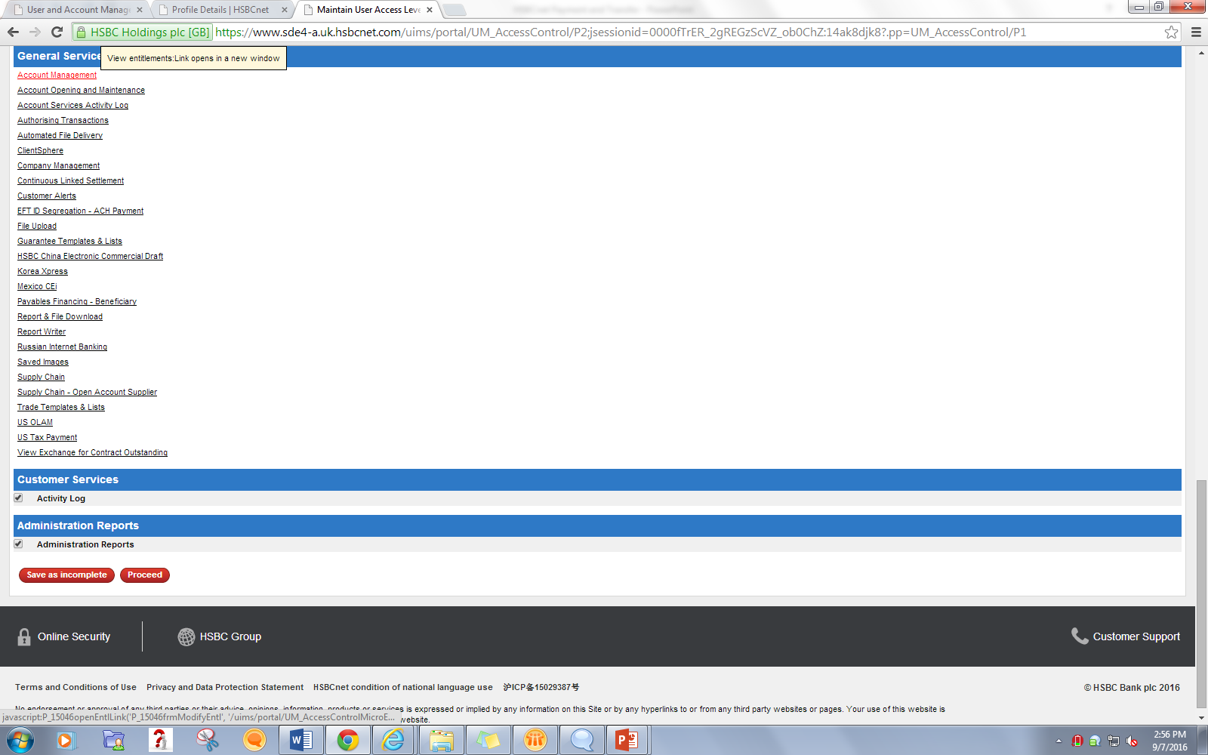
Account Management Tool (AMT)

Slide 5
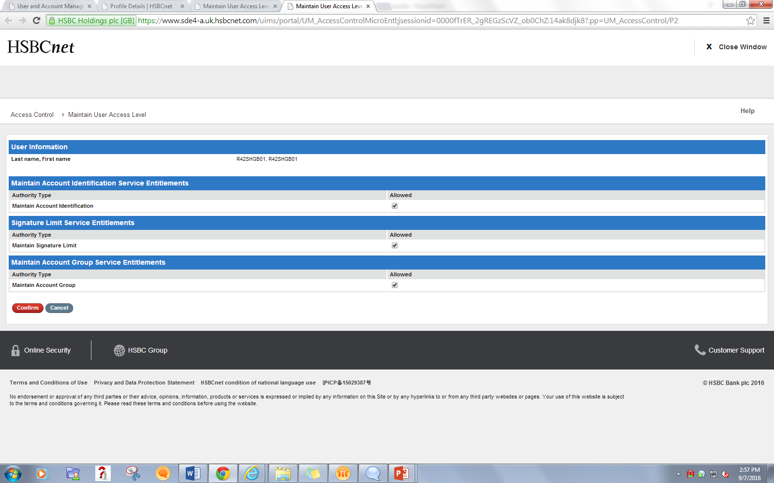

Slide 6
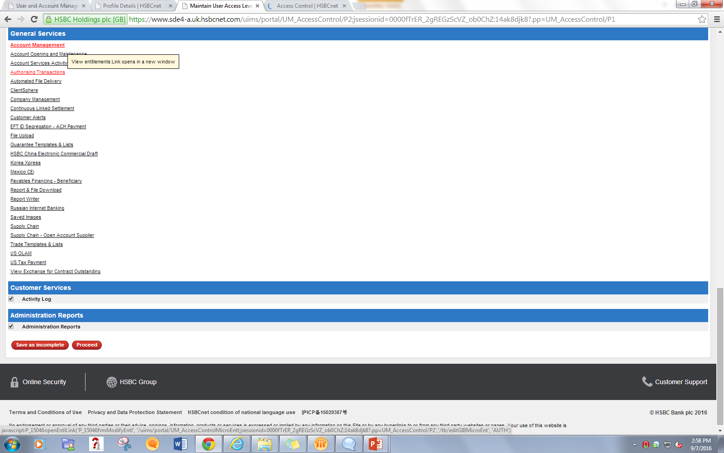
Authorizing Transactions

Slide 7
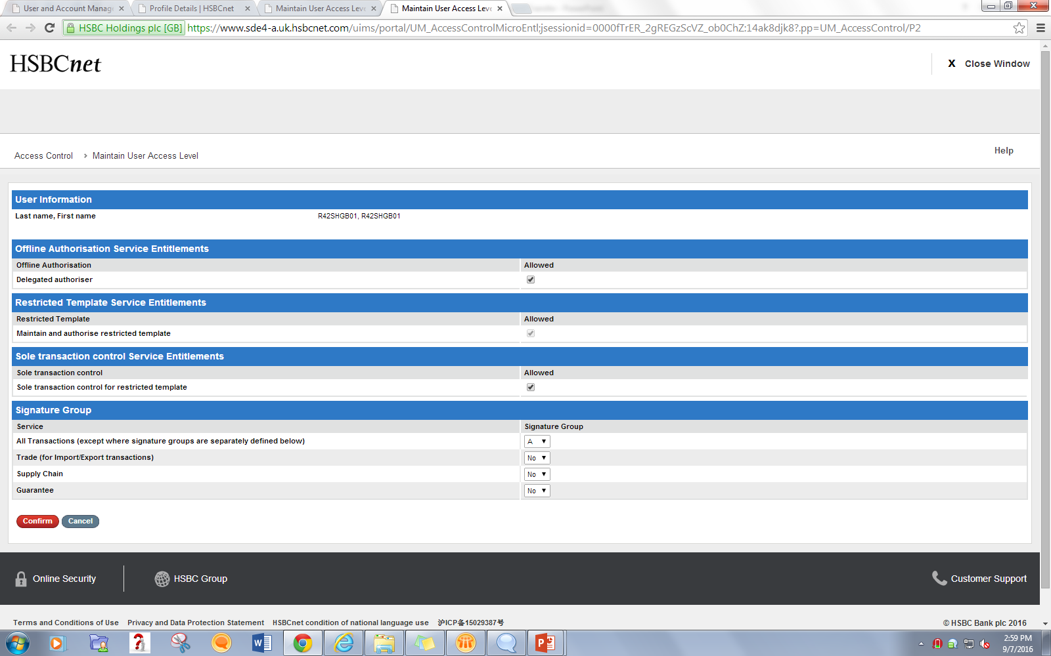

Slide 8
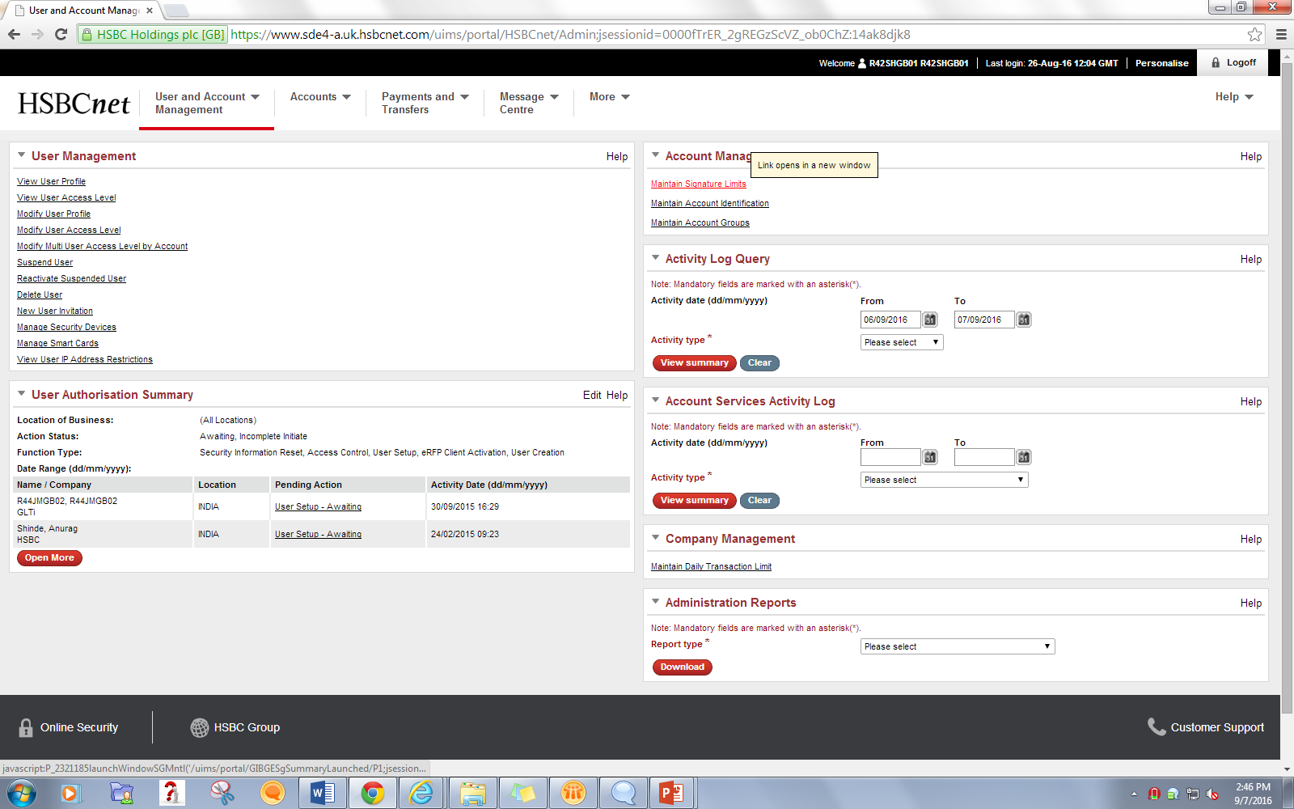
Maintain Signature Limits
Maintain Signature Limits

Slide 9
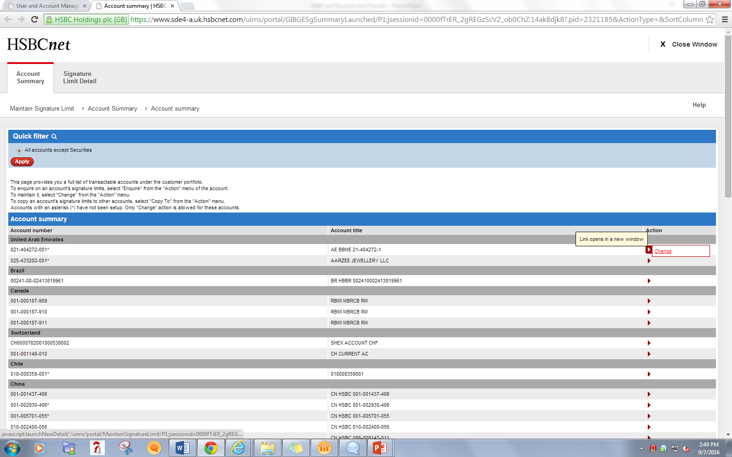

Slide 10
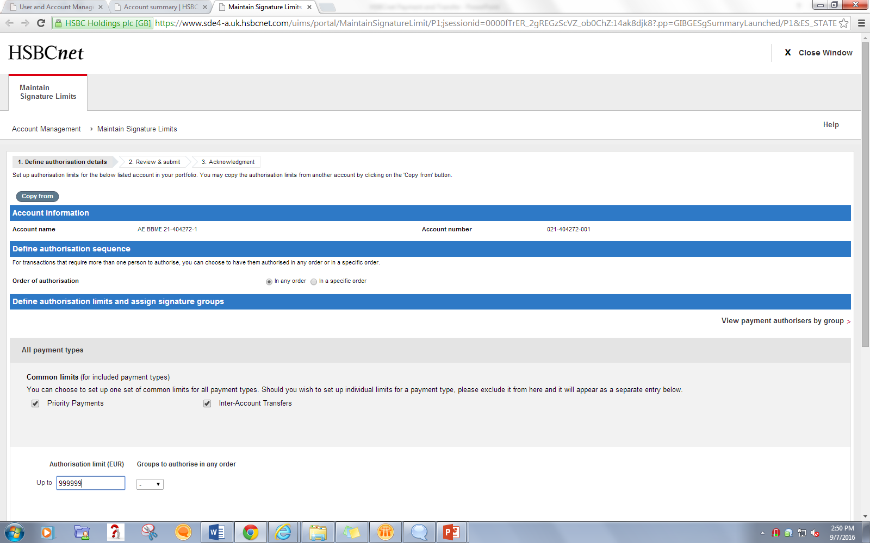
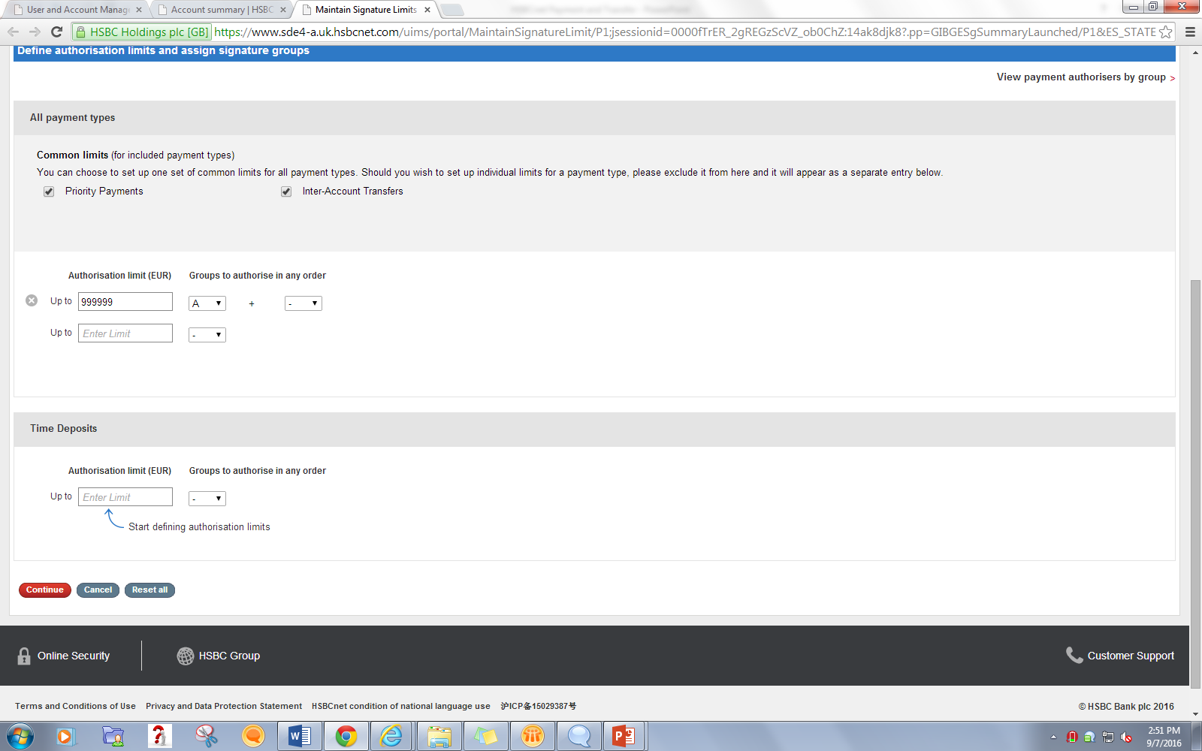

Slide 11
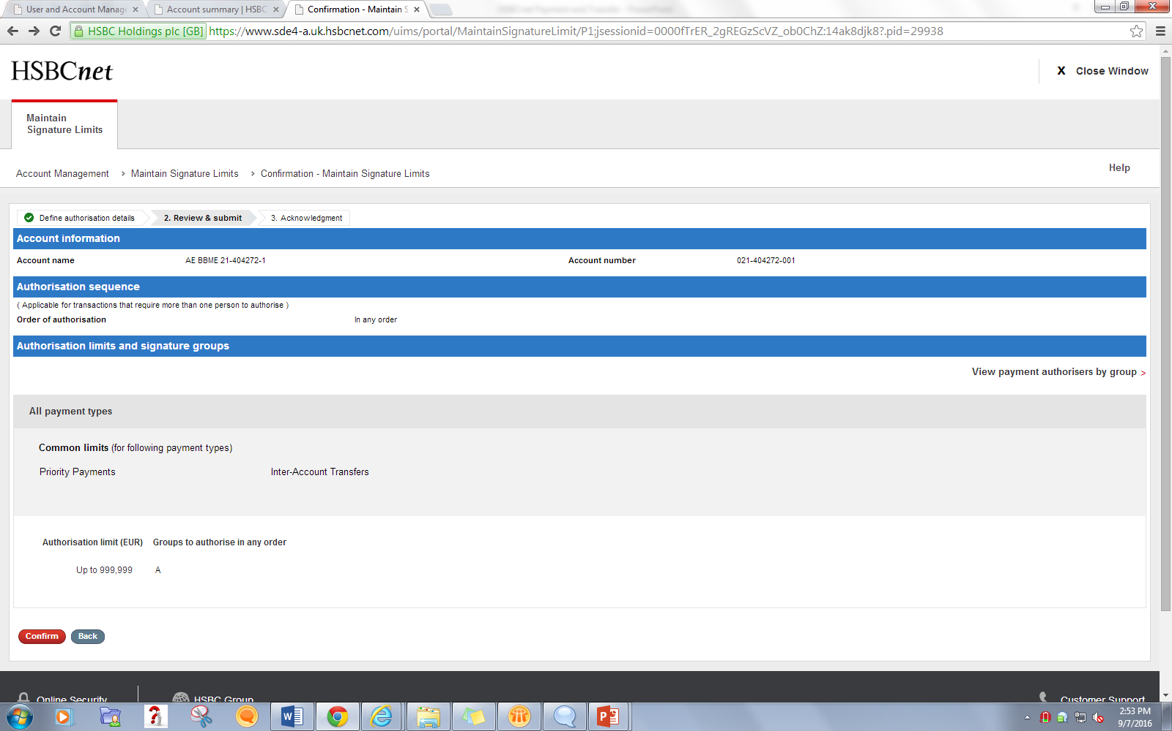

Slide 12
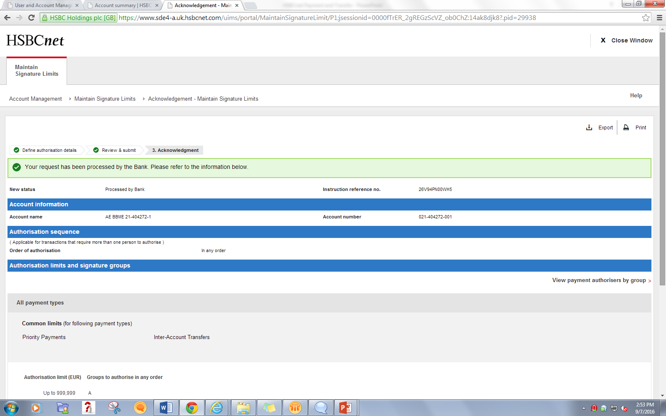
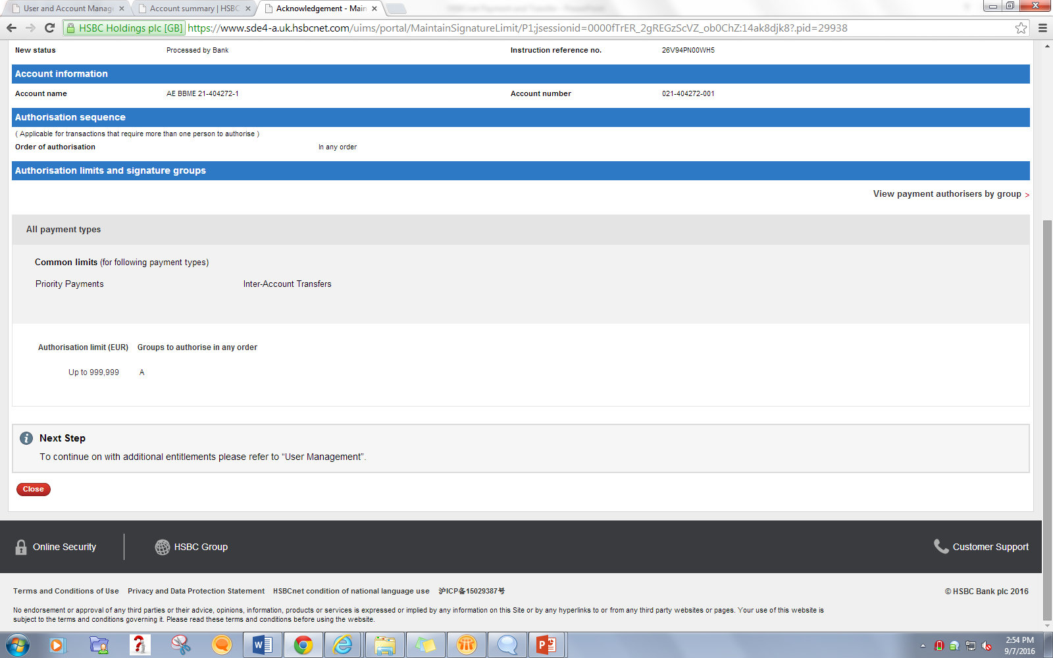

Slide 13
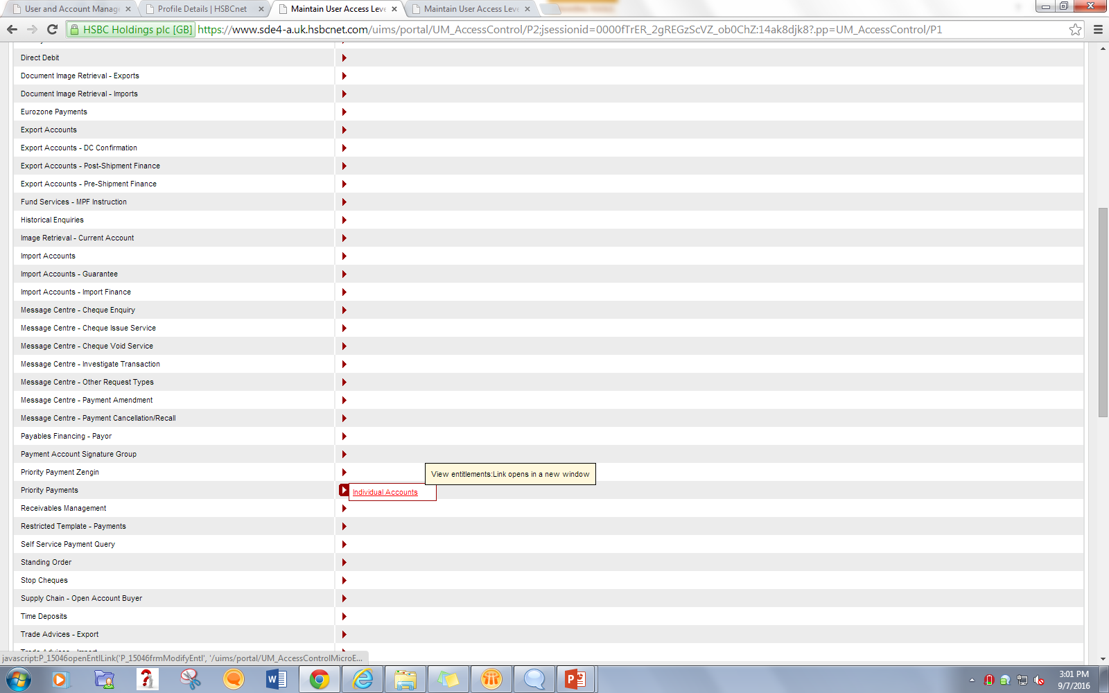
Particular Payment Type Entitlement
Click on Required Payment Type Link from account services

Slide 14
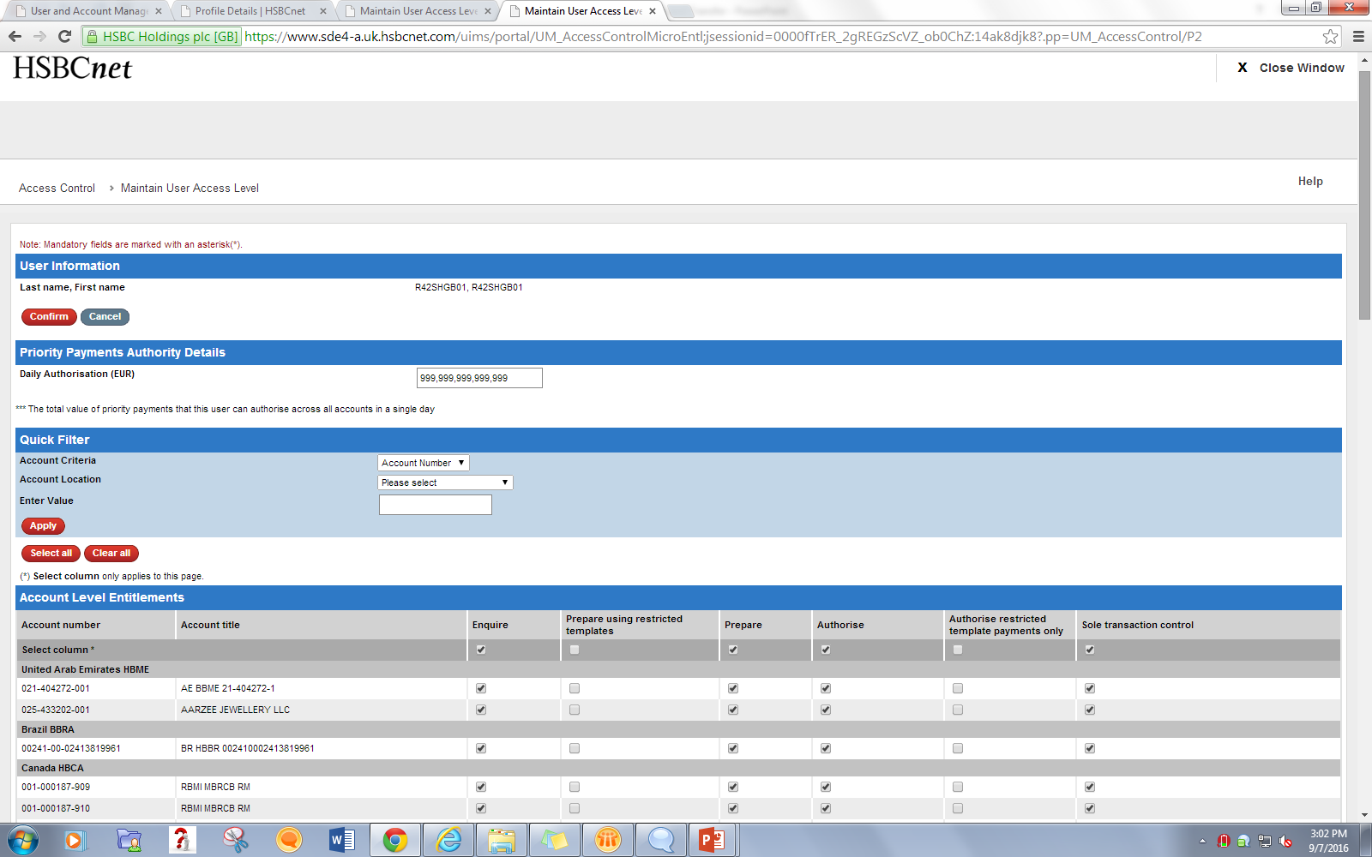

Slide 15
Payment Tools
After all entitlements following tools will be available for users:
Create Payment Instruction
Authorization Summary
Payment Summary
Create Payment Template
Template Summary

Slide 16
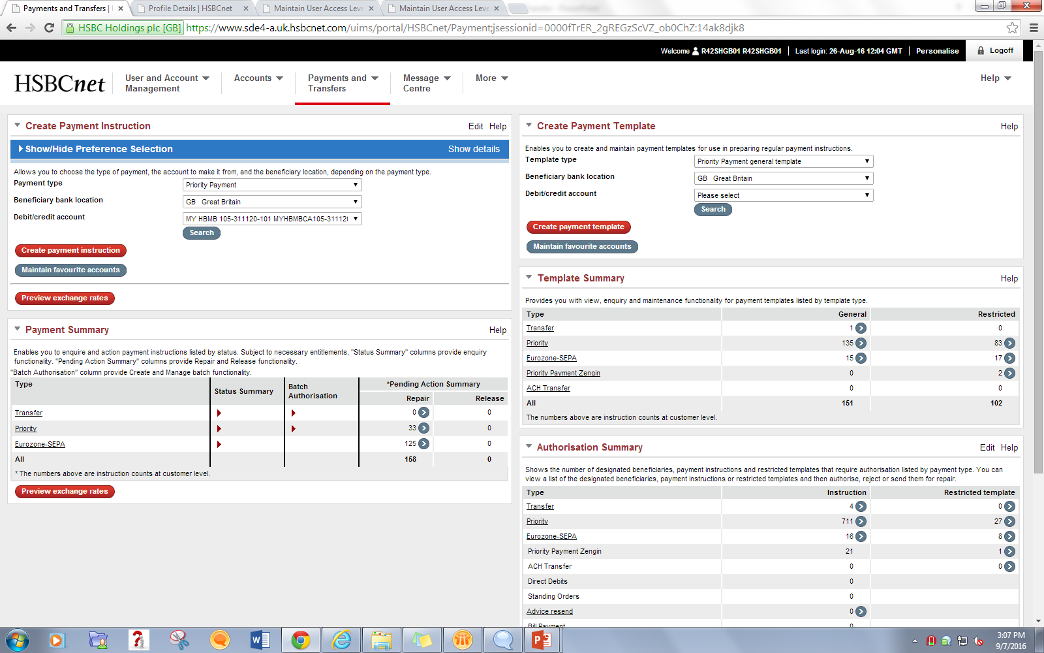

Slide 17
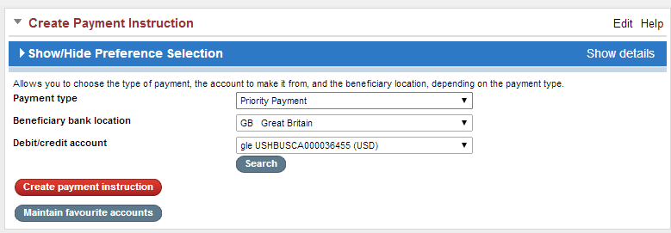
Create Payment Instruction

Slide 18
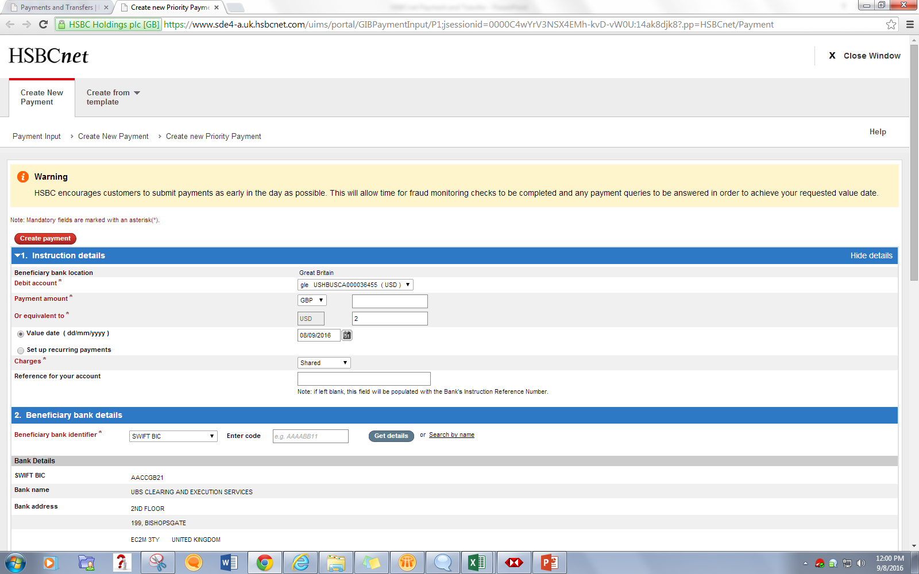

Slide 19
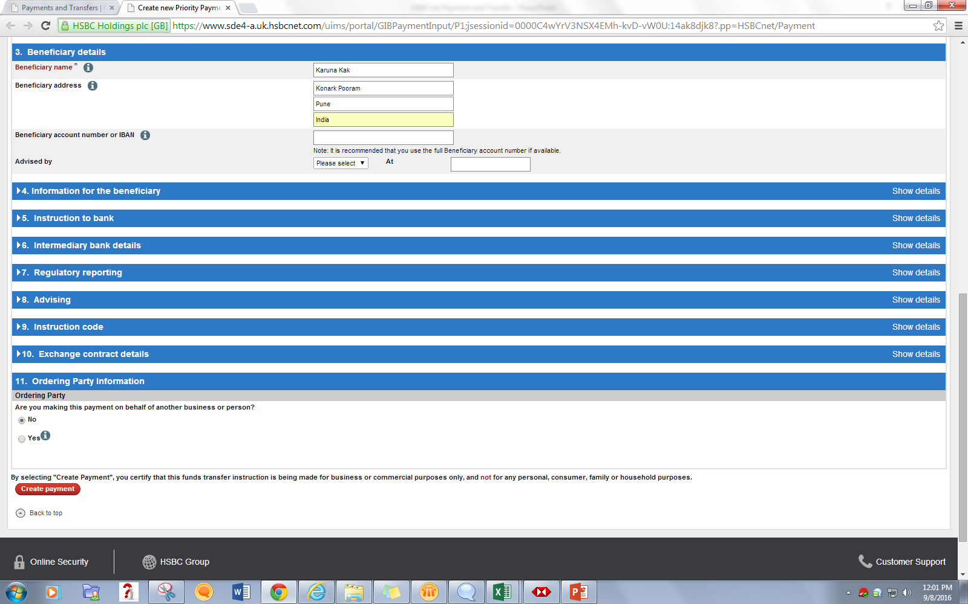

Slide 20
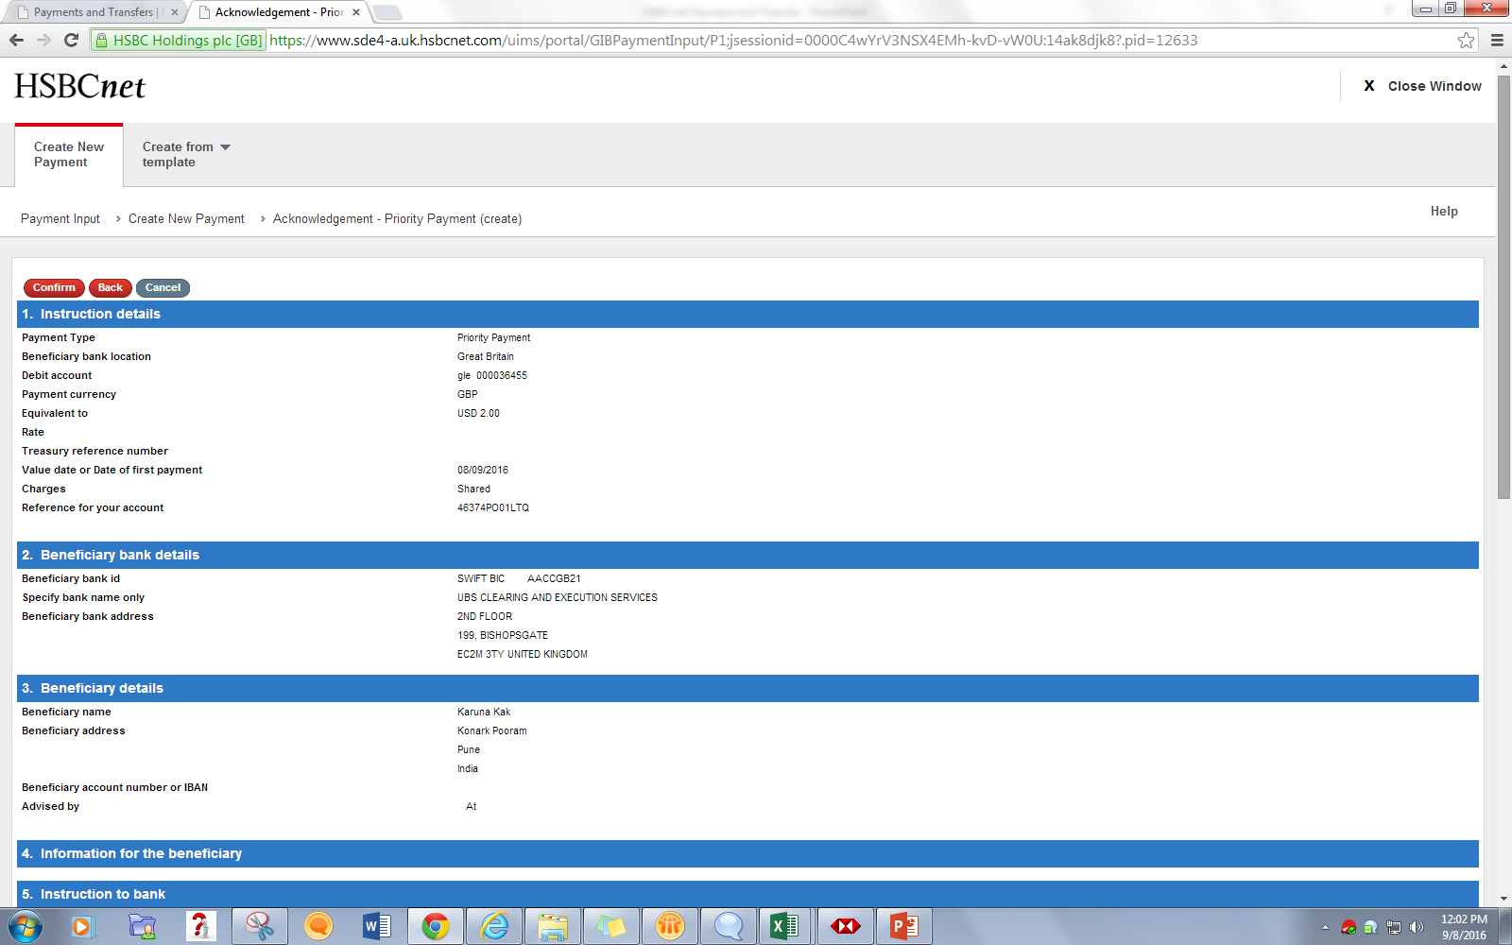
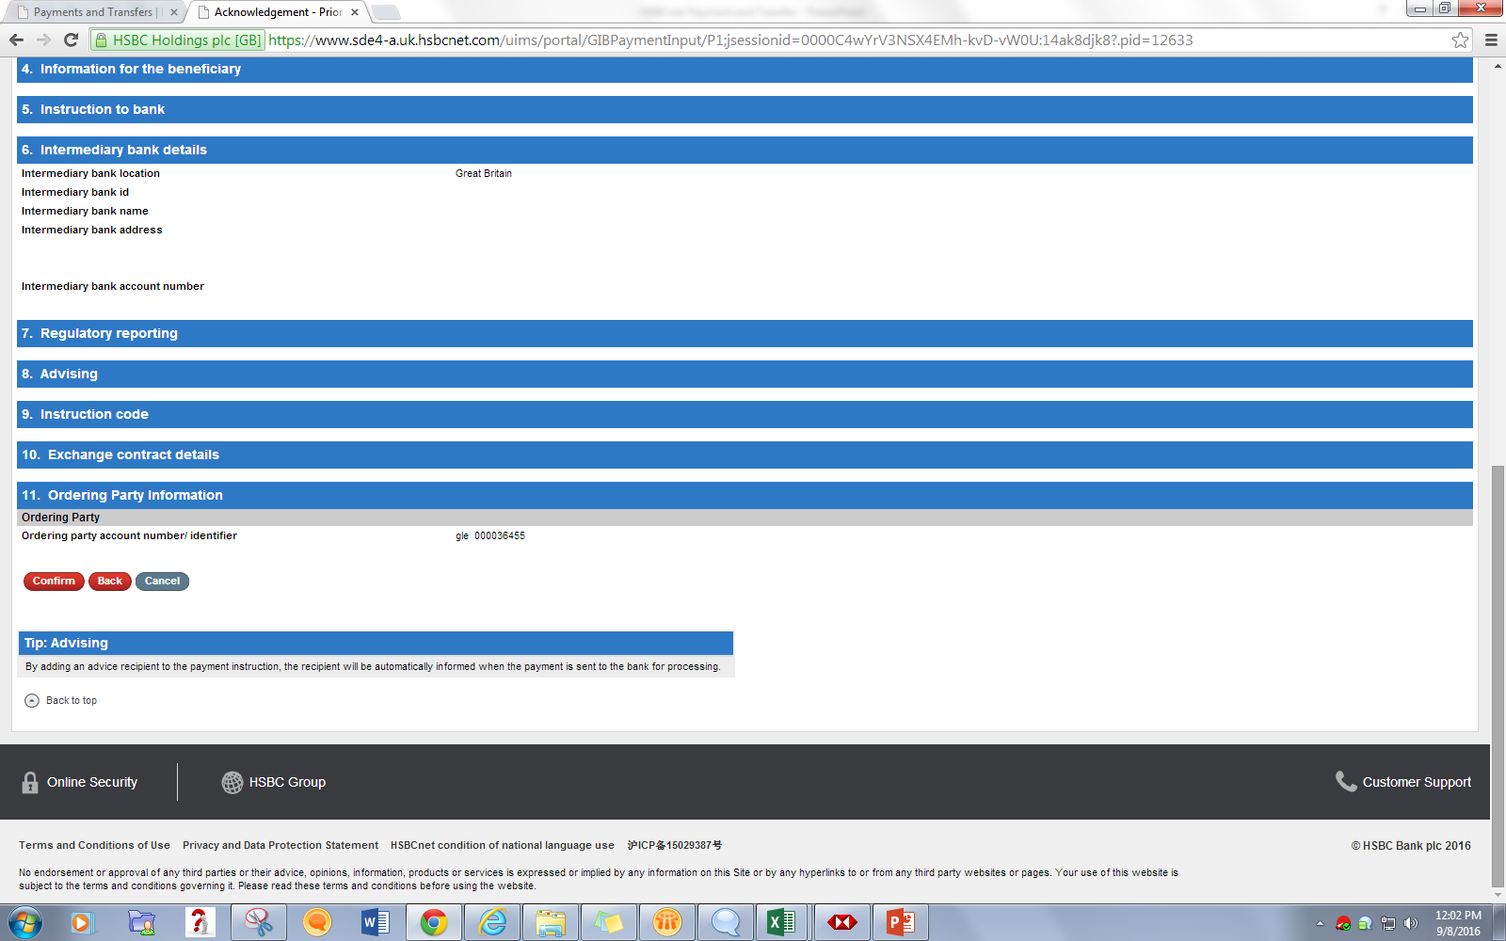

Slide 21
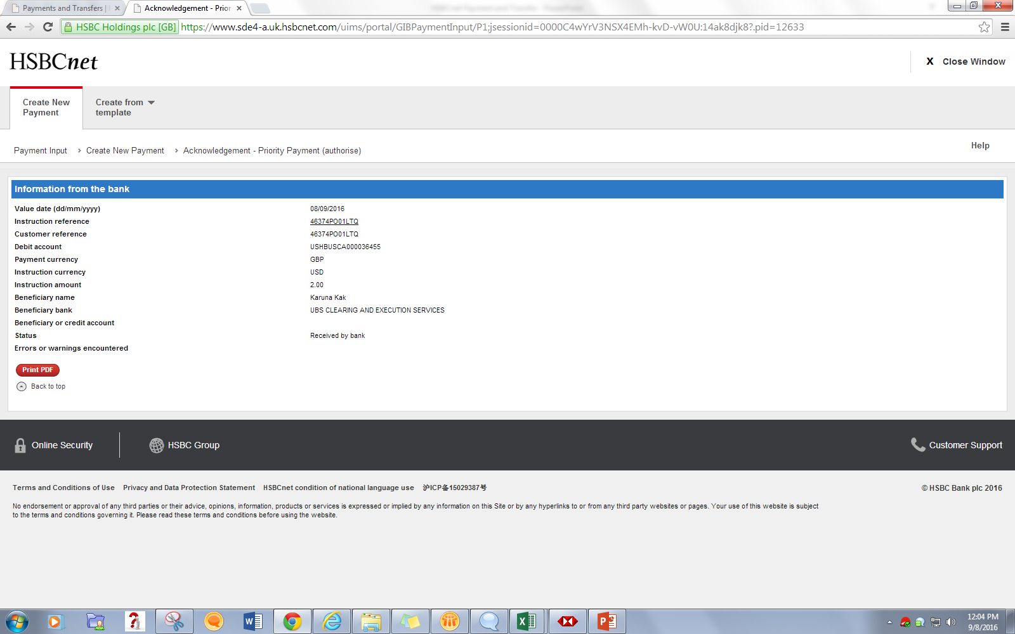

Slide 22
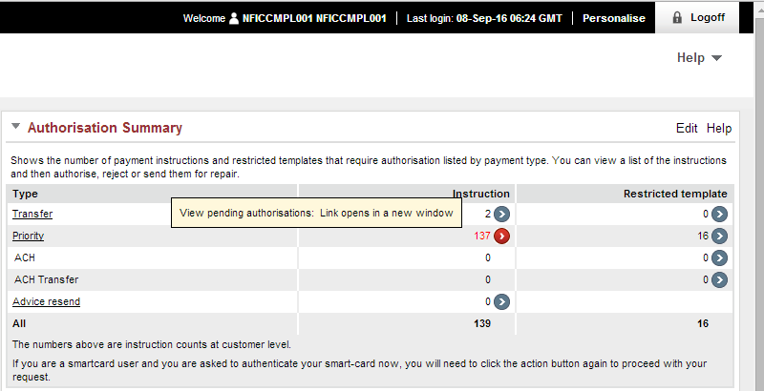
Authorization Summary Action: Authorize
Create a payment and keep it in Pending Auth.

Slide 23
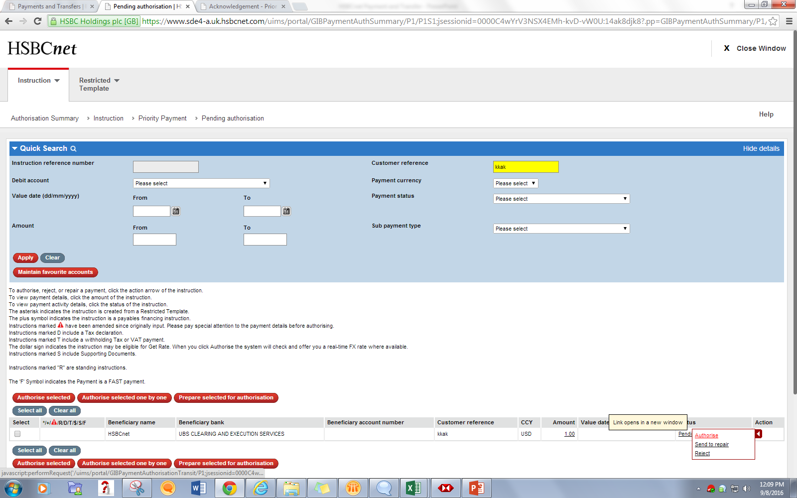
Once Instruction is created user can either Authorize/Repair/Reject the instruction from the Authorization Summary

Slide 24
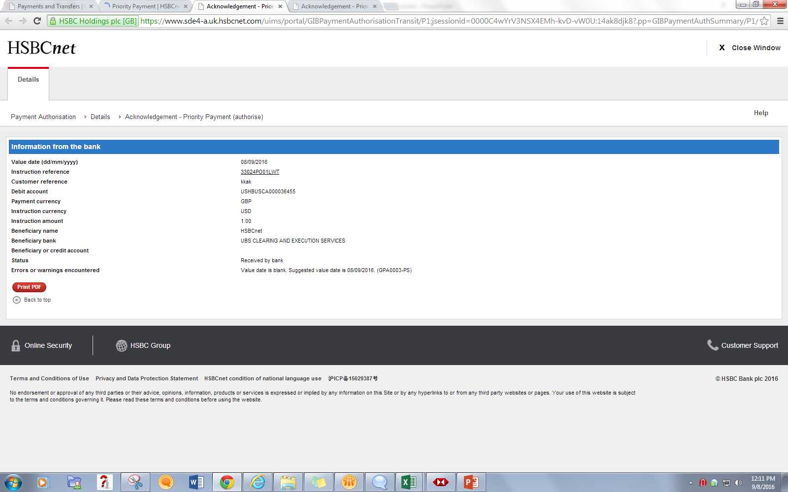

Slide 25
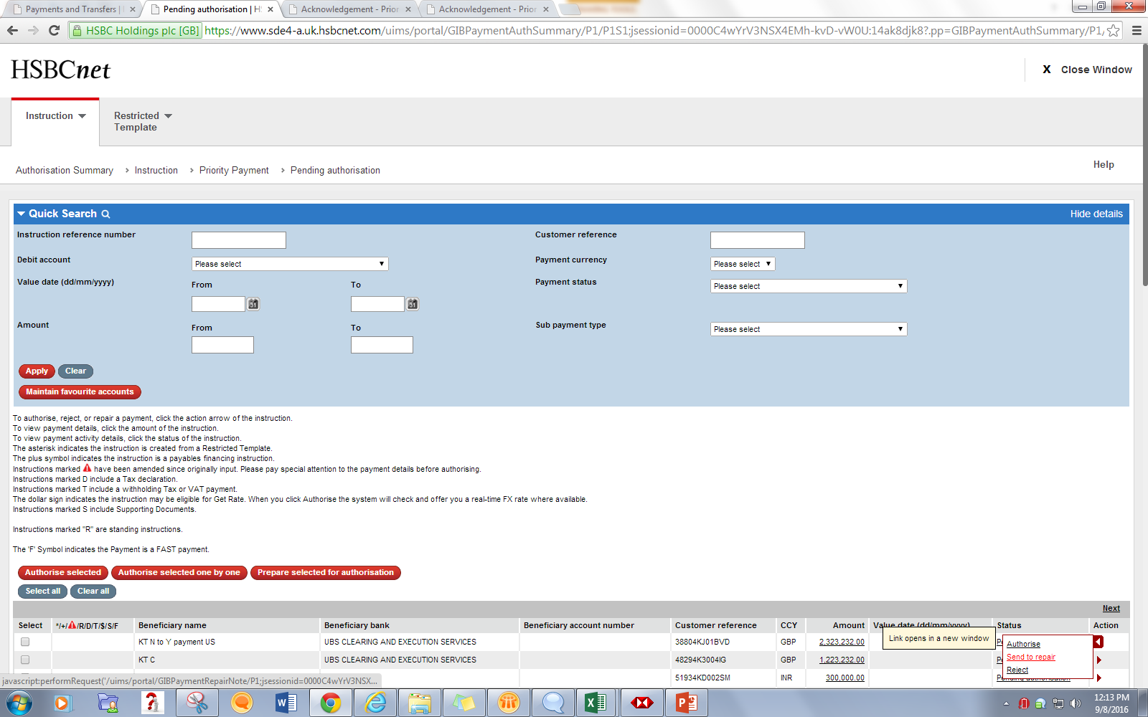
Action : Send to Repair

Slide 26
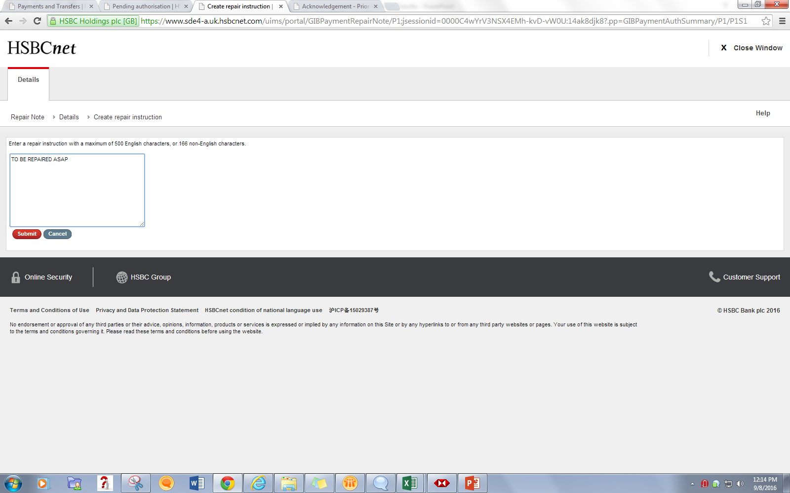

Slide 27
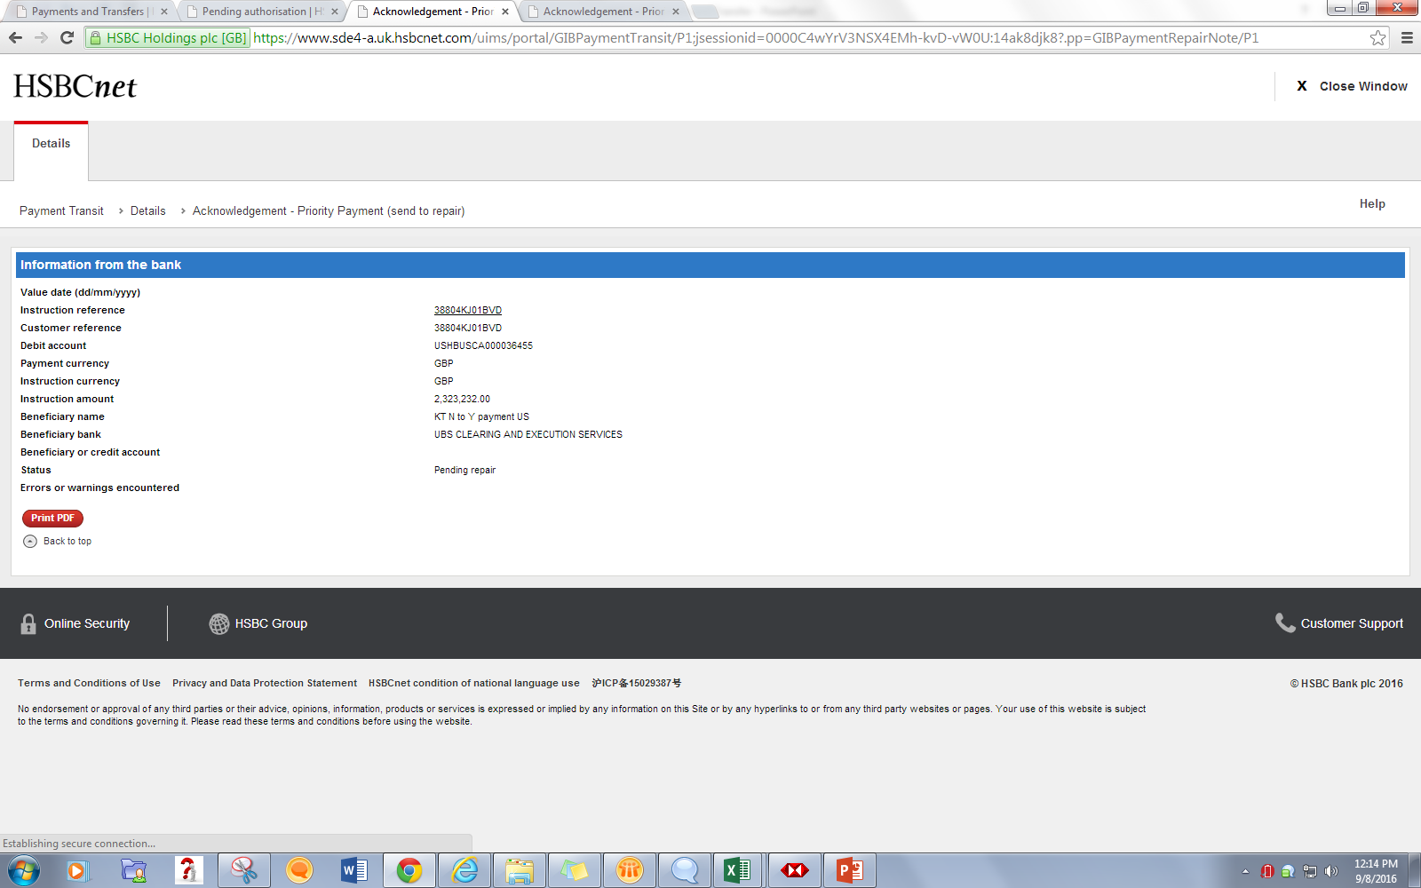

Slide 28
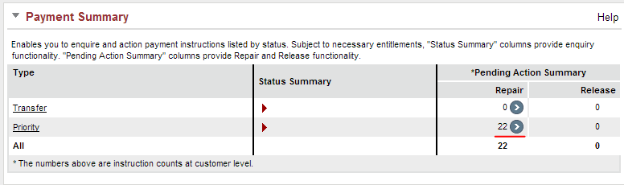
The pending Repair count in the Payment Summary increments by one.

Slide 29
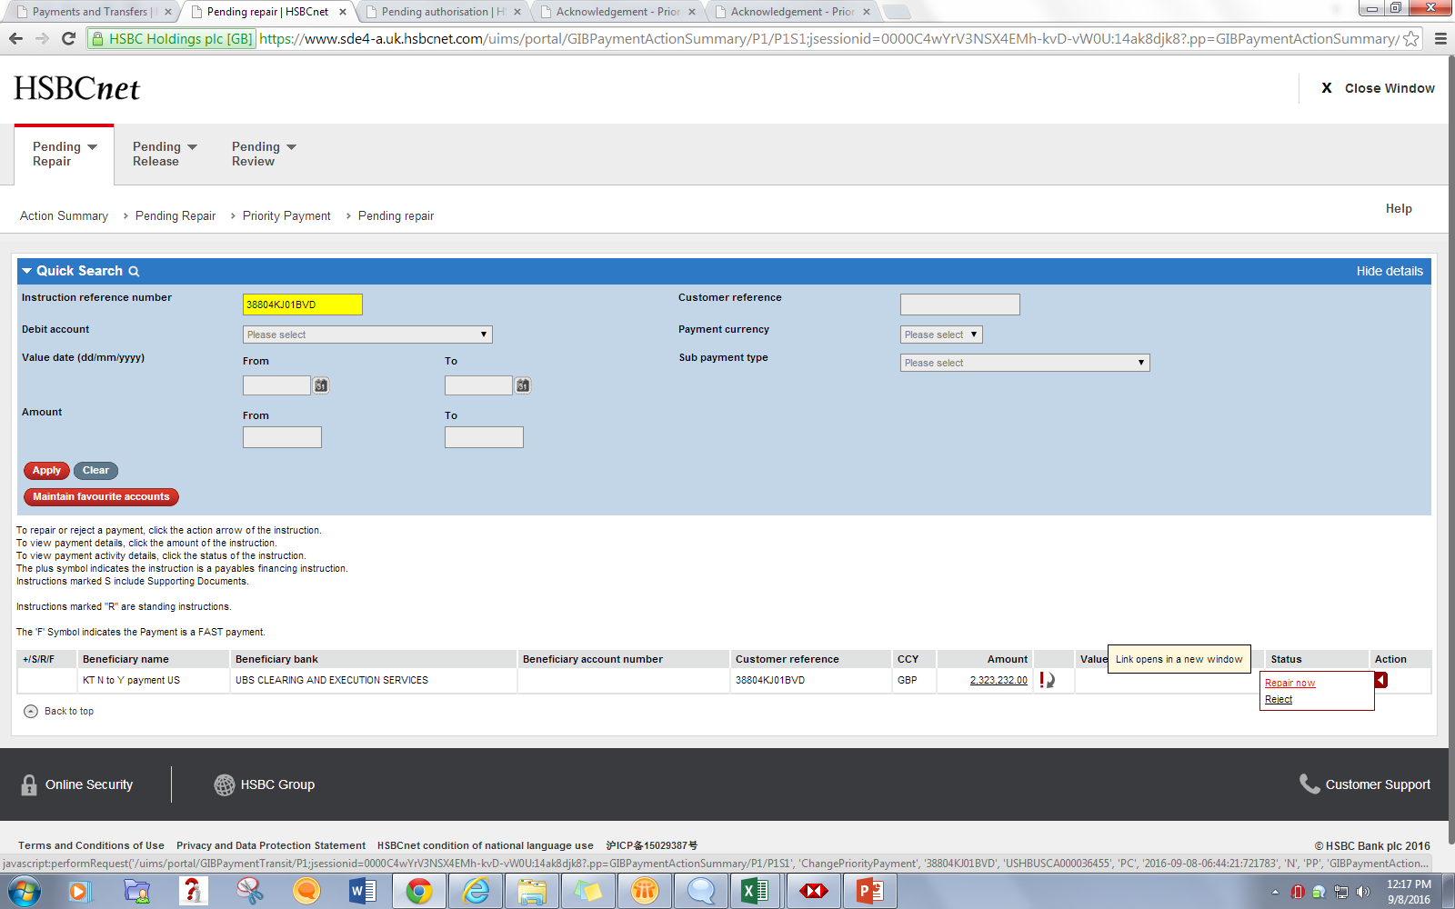

Slide 30
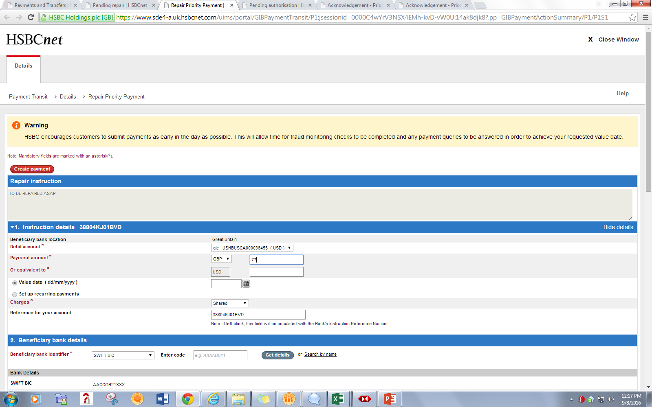

Slide 31
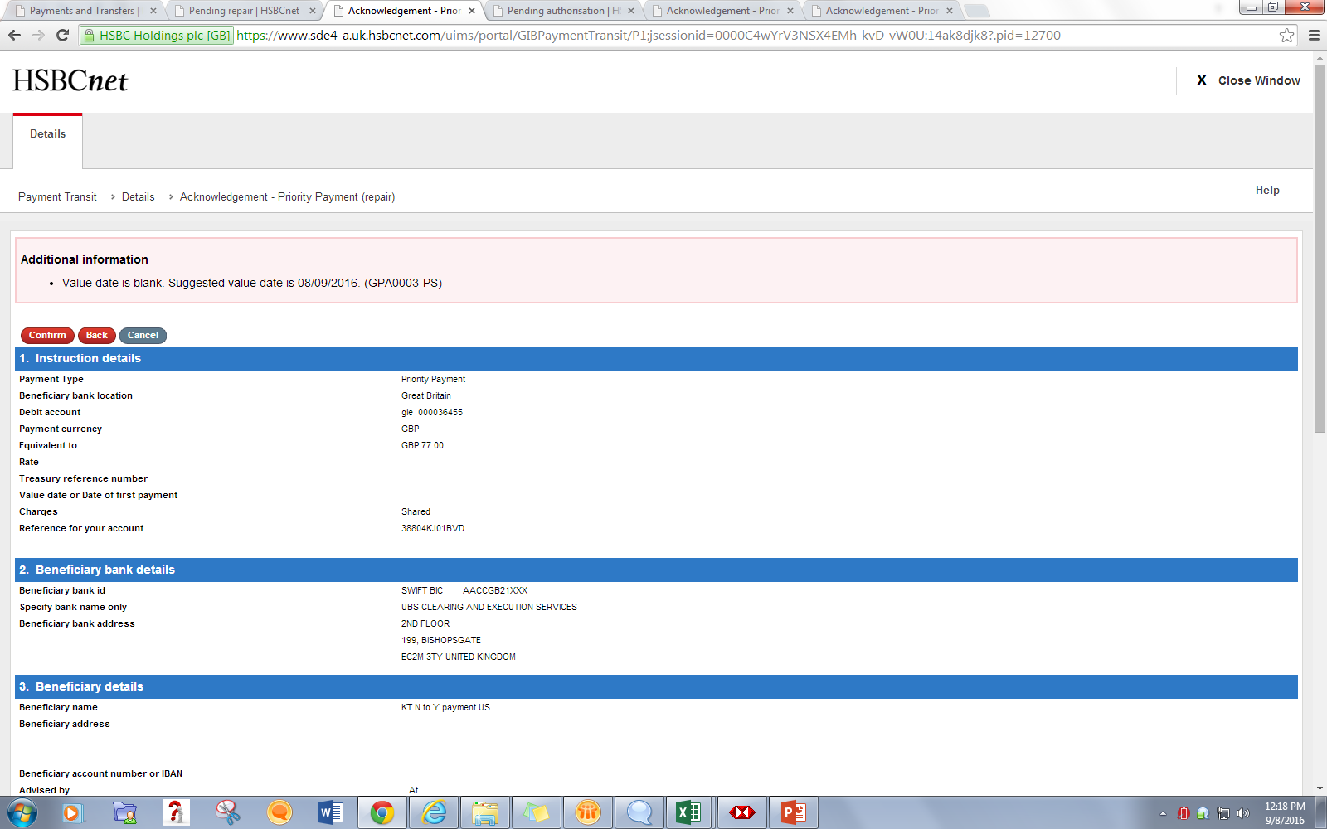

Slide 32
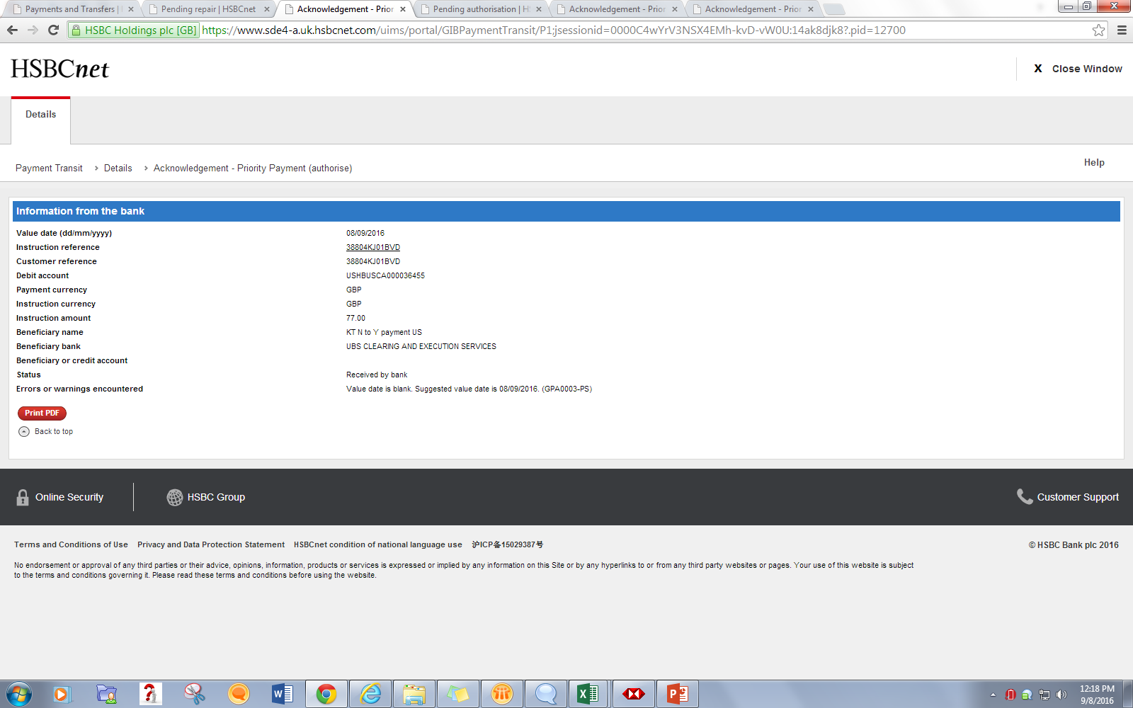

Slide 33
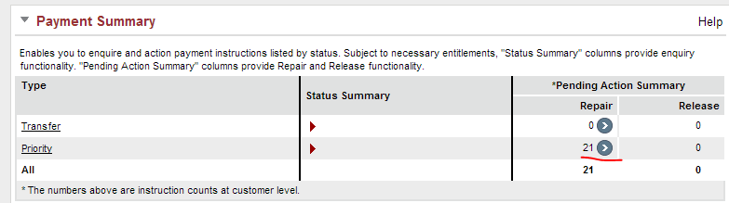
After acknowledgement, the pending repair count in the Payment Summary decrements by one.

Slide 34
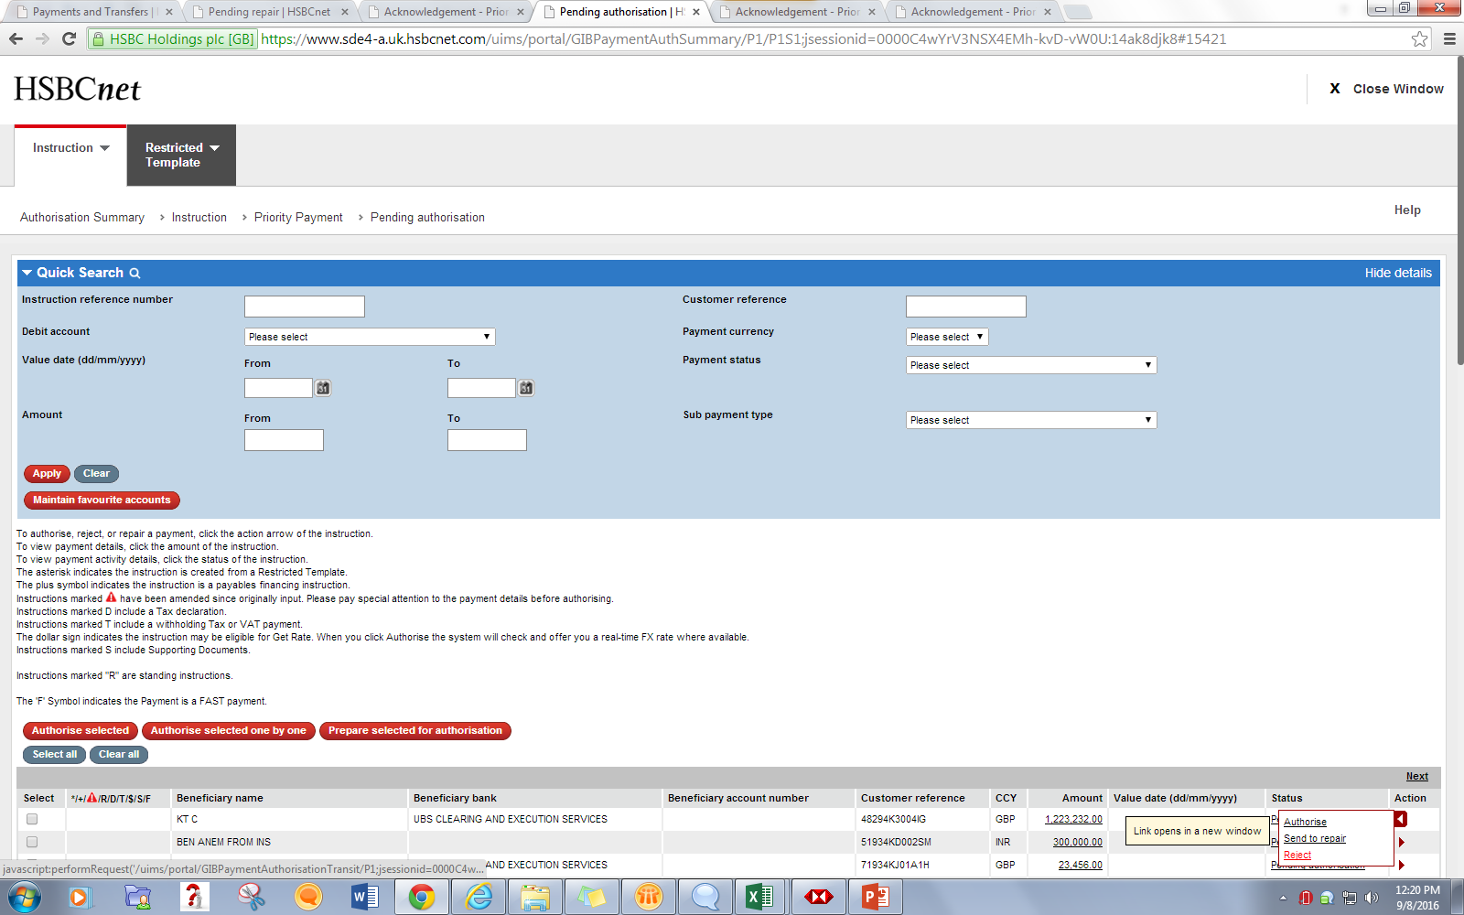
Action : Reject

Slide 35
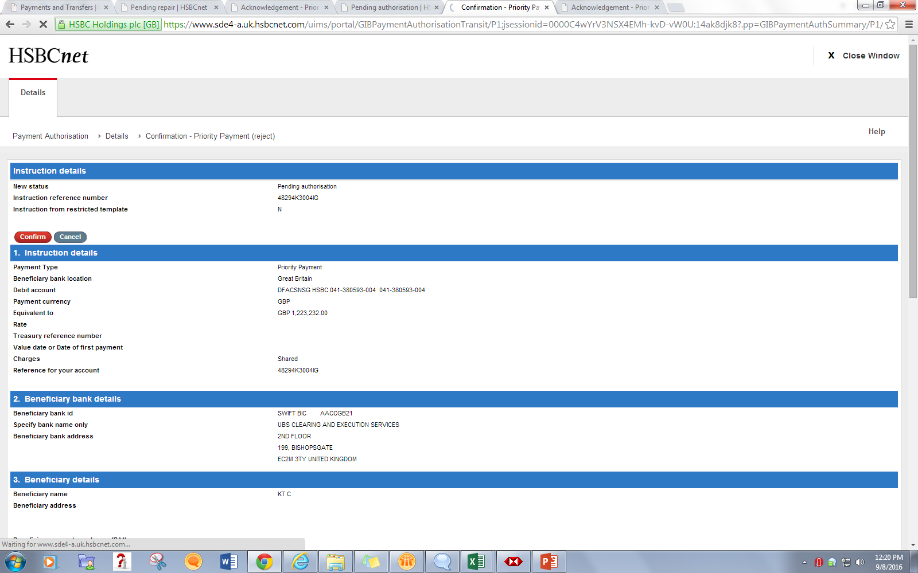

Slide 36
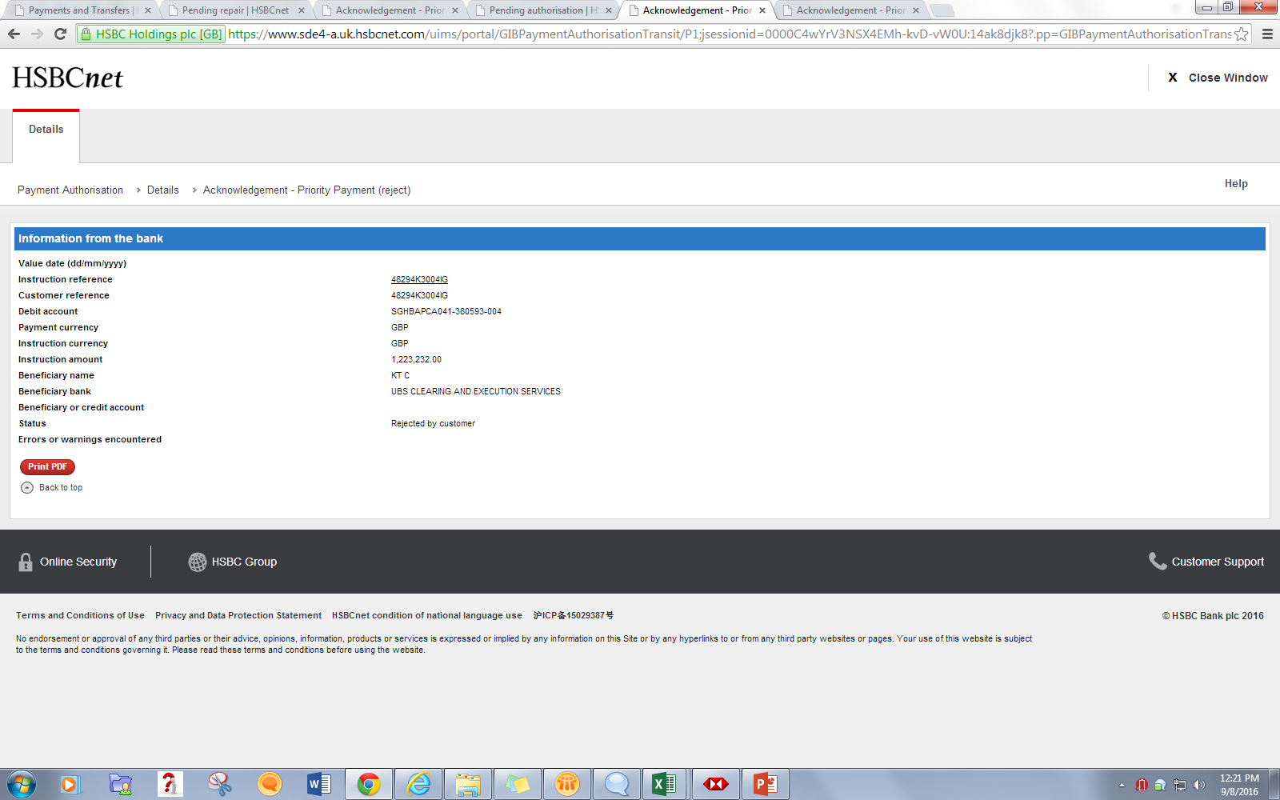

Slide 37
Payment Templates
Payment can also be created using a Template
User can create a Template and every time he can use same Template for Payment Instruction creation
This saves time and also reduces complexity
Template fields are exactly same as that of Payment fields except one field “Template ID”
User can never give the same Template ID for templates.

Slide 38
Template Types
General Template
These are low level templates (like small amount template).
In the General Template screens, none of the fields are mandatory except for the Template ID.
General Template does not require any authorization after its creation.
Restricted Template
These are High level Templates (like large Amount templates) and needs to go through single level authorization.
Only the user having Maintain and Authorize Restricted Template right can Authorize the restricted template.
Payment Creation from restricted will only be possible if user is having Prepare Using Restricted Template right for particular account.
Restricted Template requires authorization from another user having the rights to authorize the template.

Slide 39
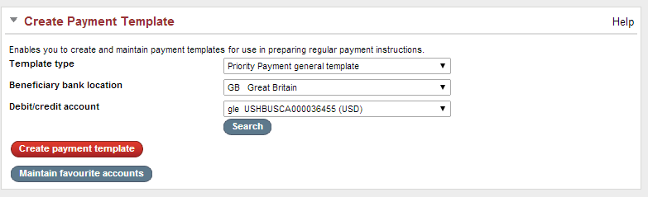
General Templates

Slide 40
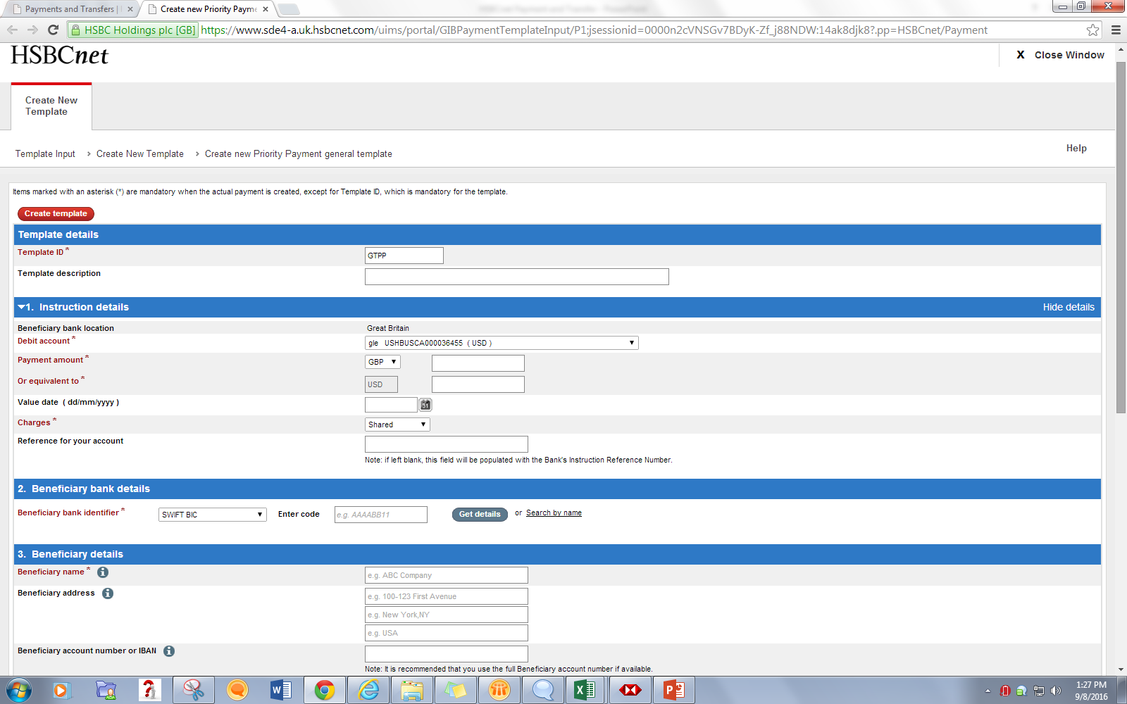
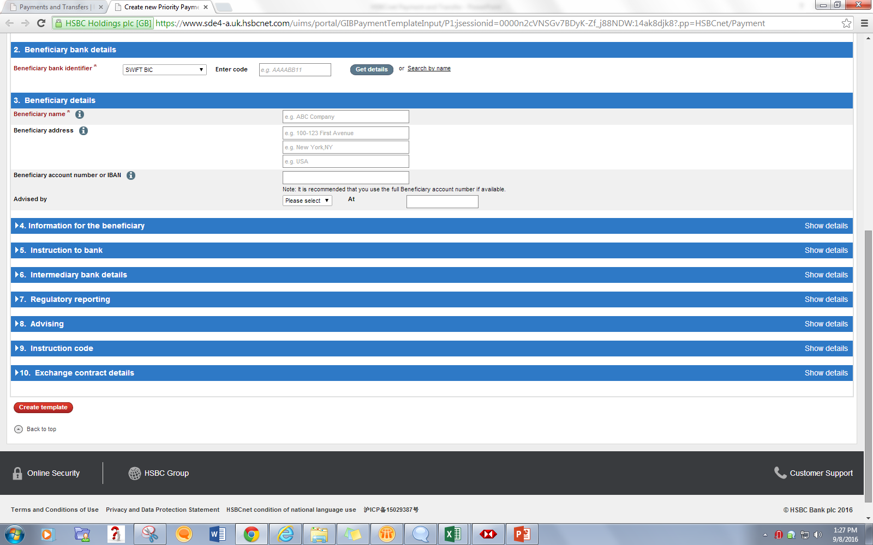

Slide 41
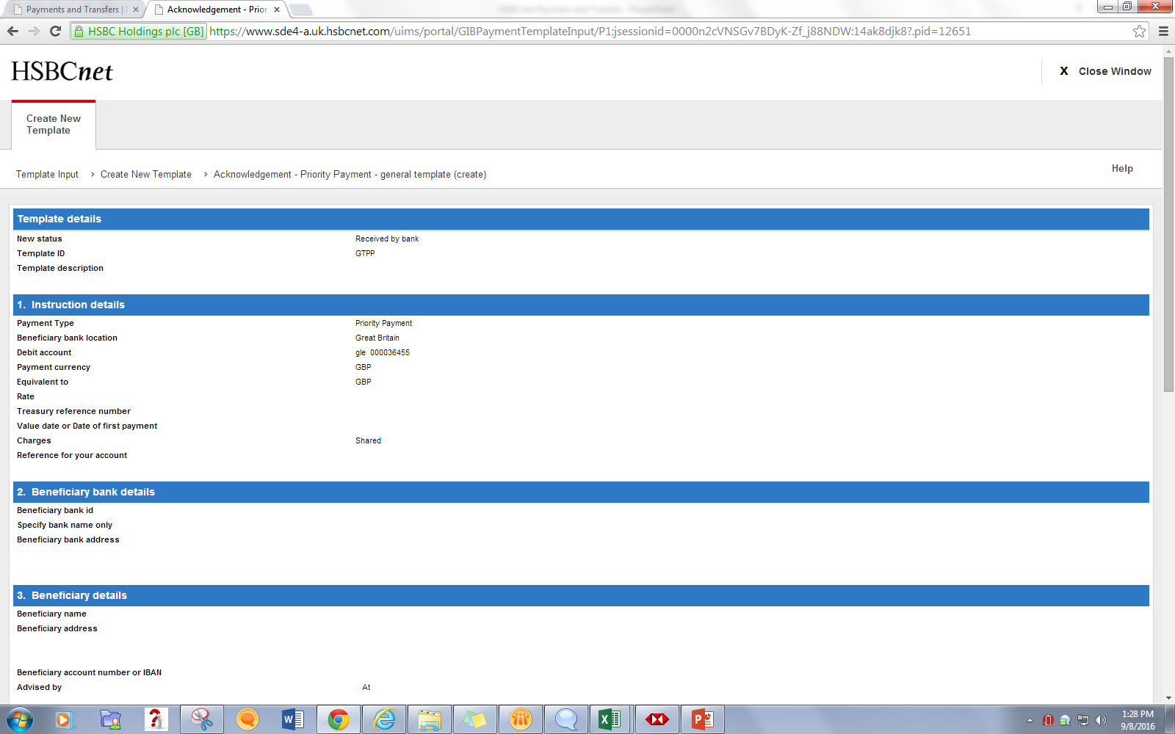
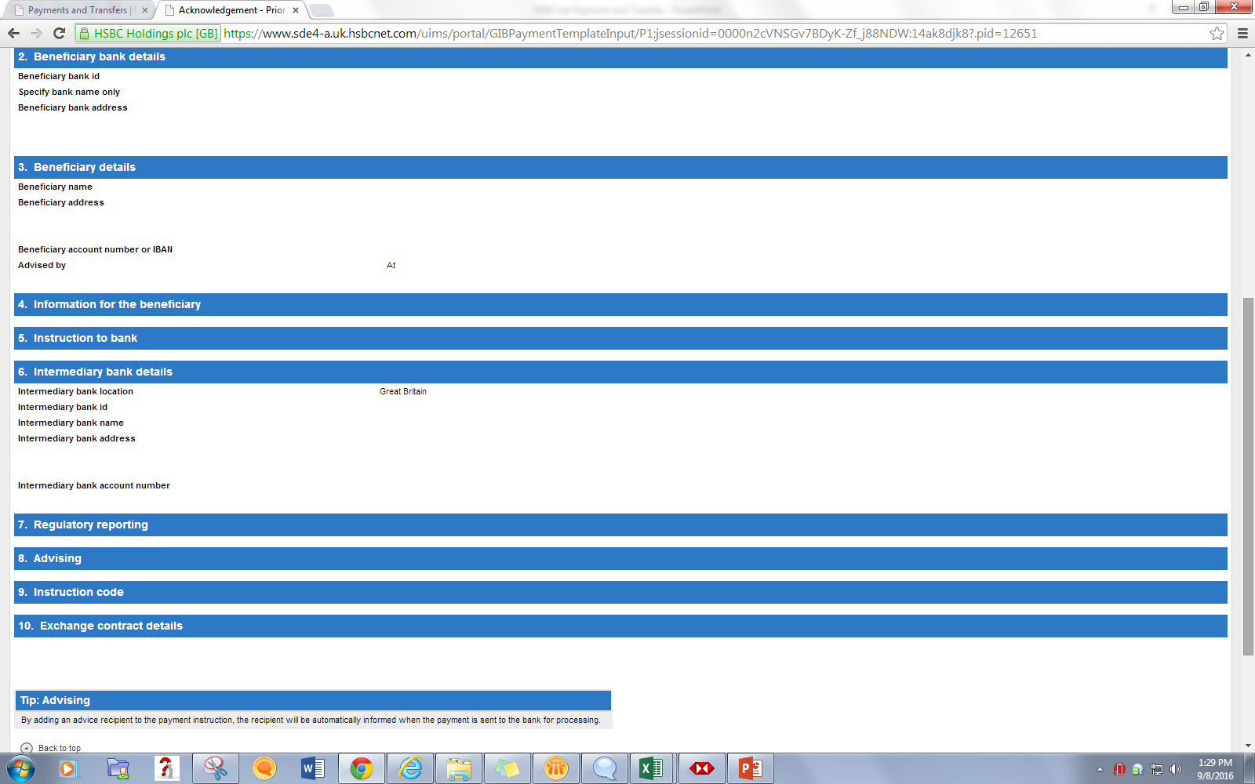

Slide 42
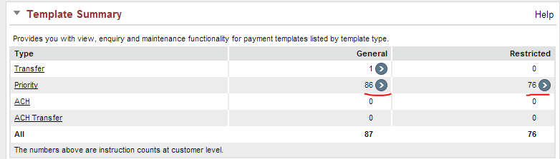
Created Template will be listed under Template Summary tool Count incremented

Slide 43
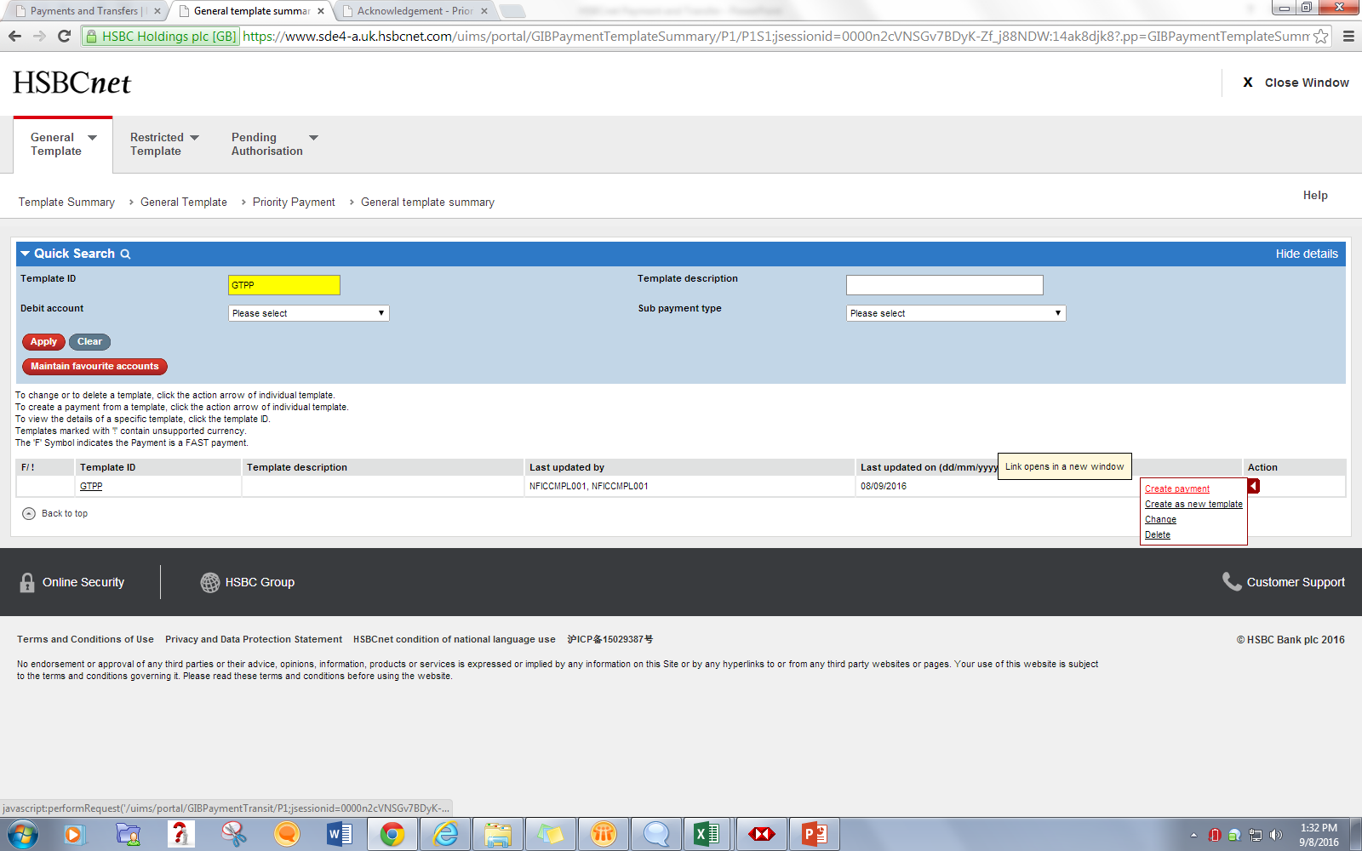
Available options

Slide 44
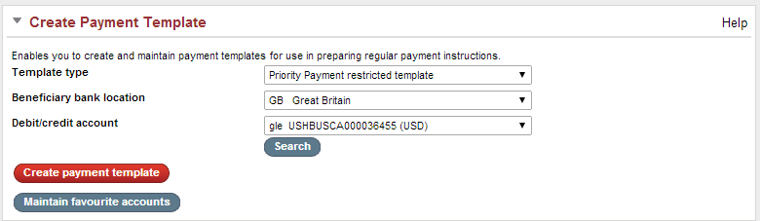
Restricted Templates

Slide 45
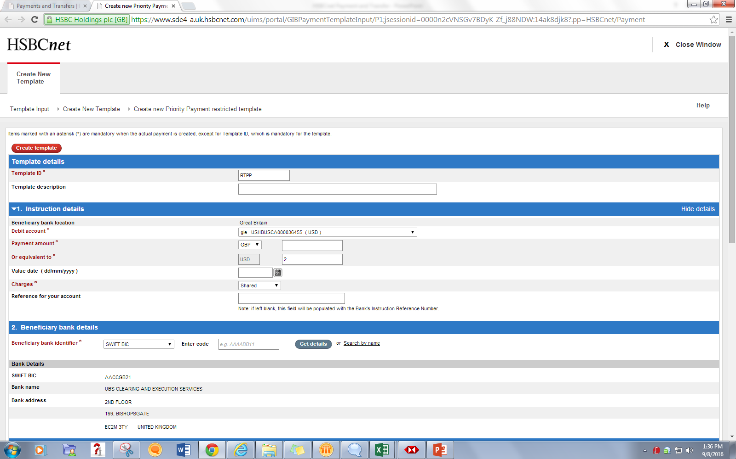
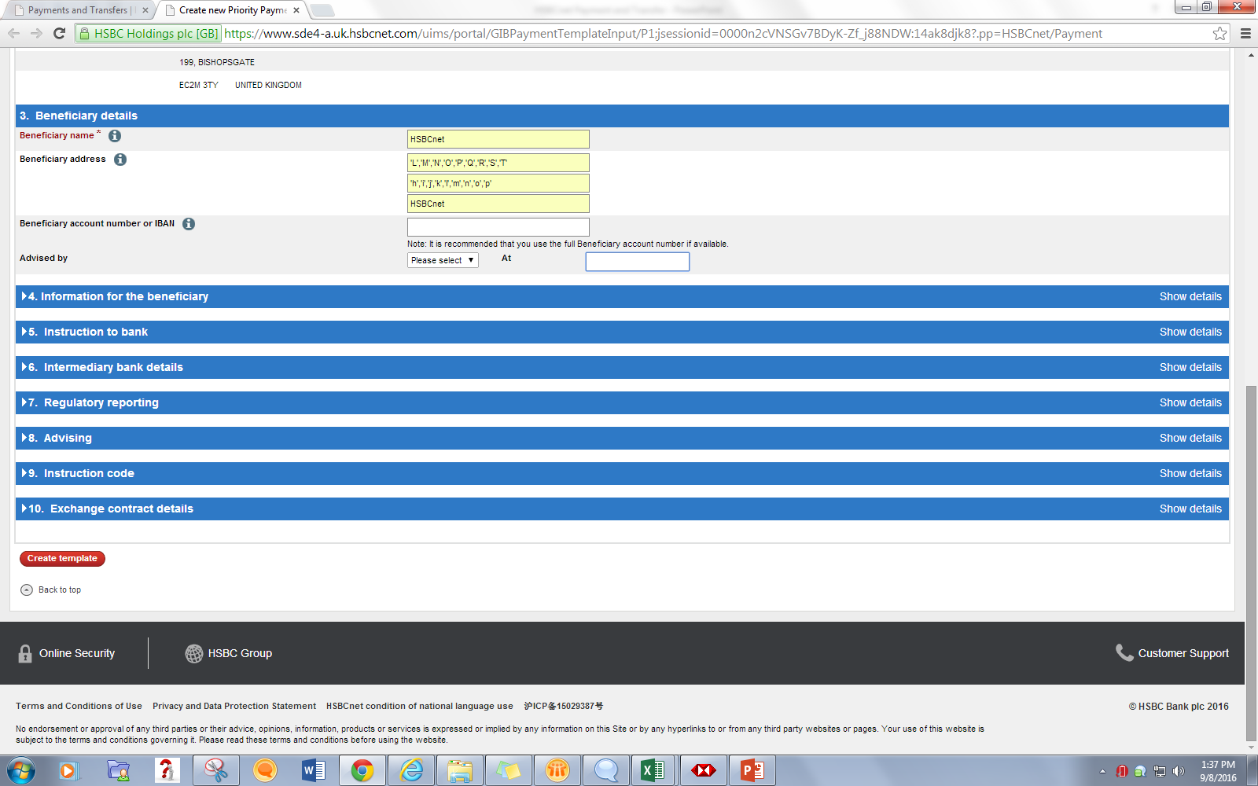

Slide 46
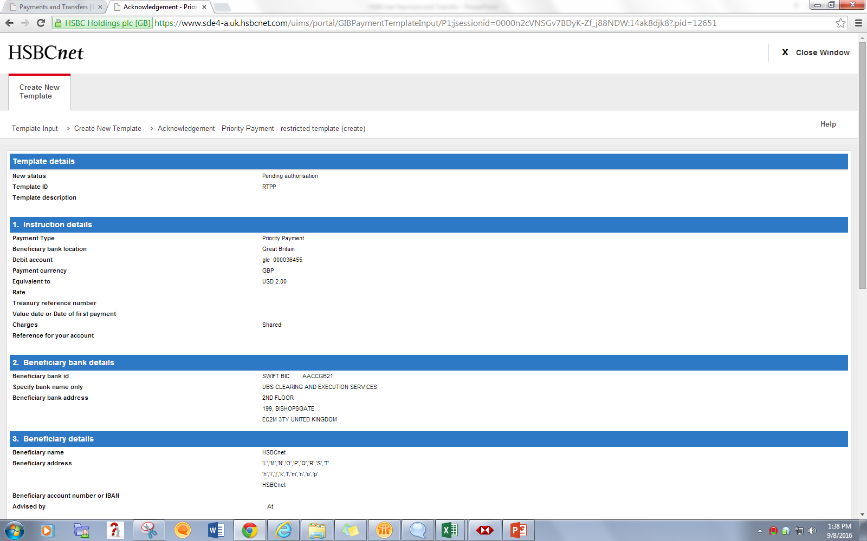
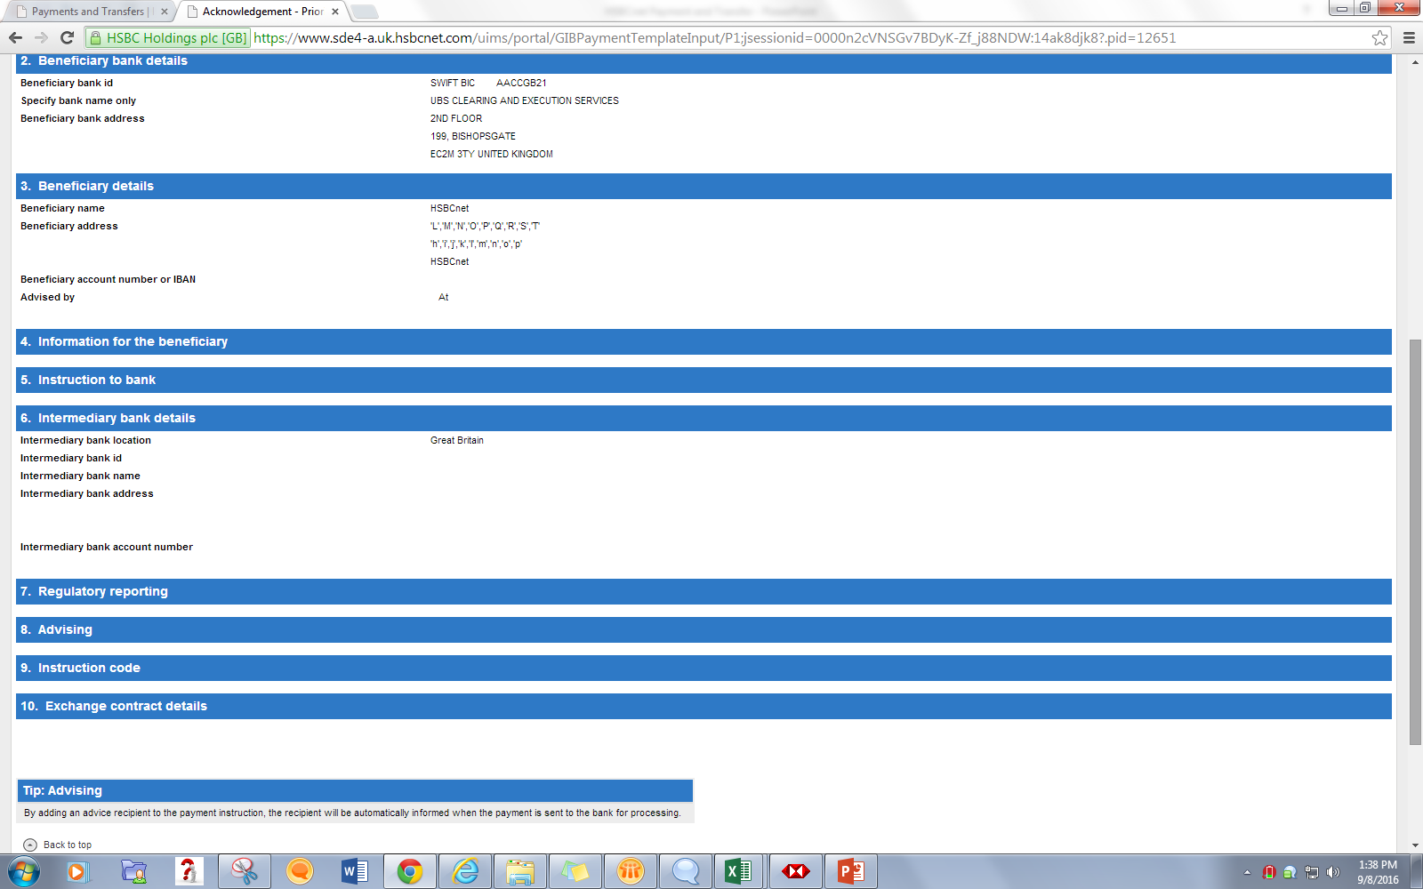

Slide 47
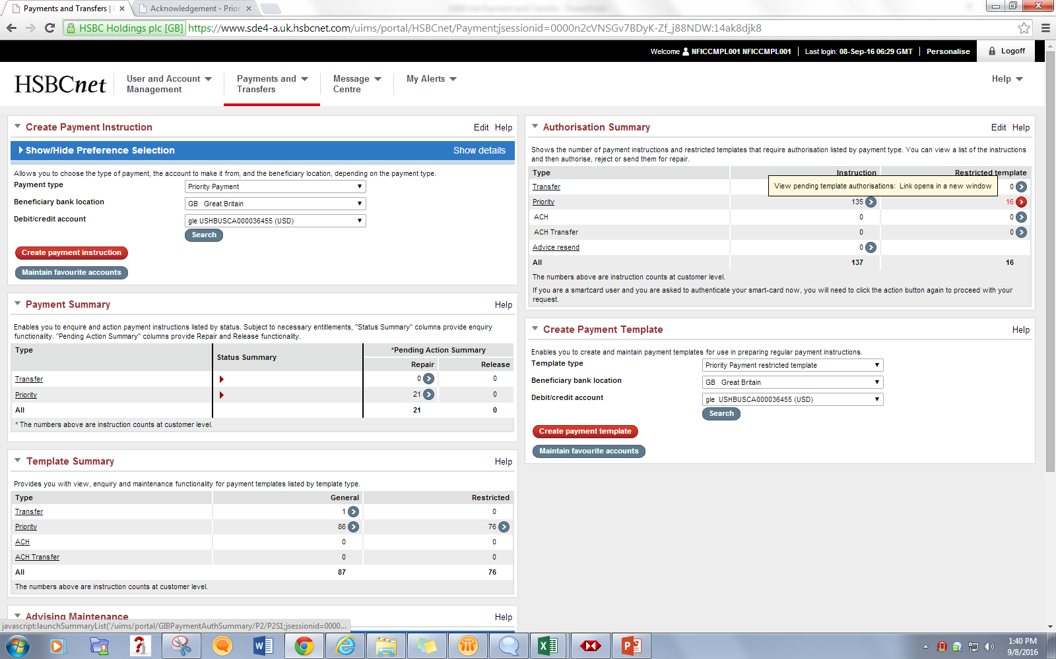
Template gets listed in Authorization Summary

Slide 48
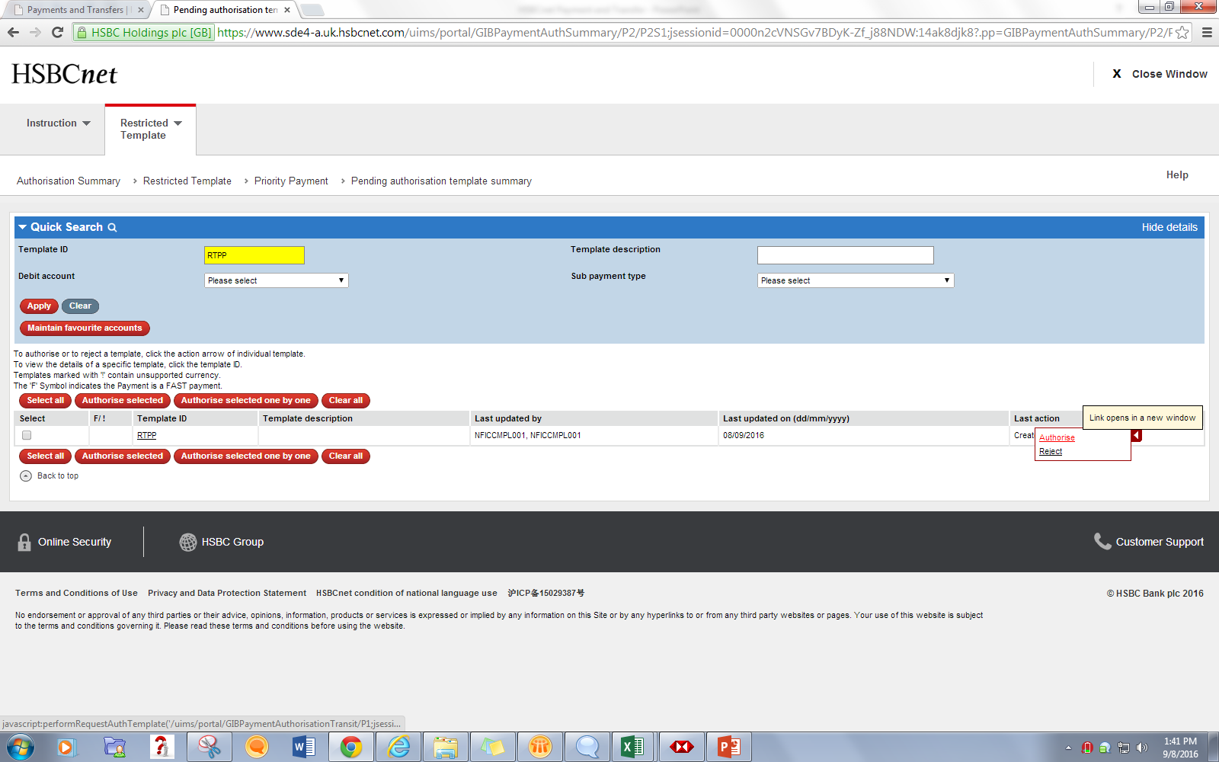

Slide 49
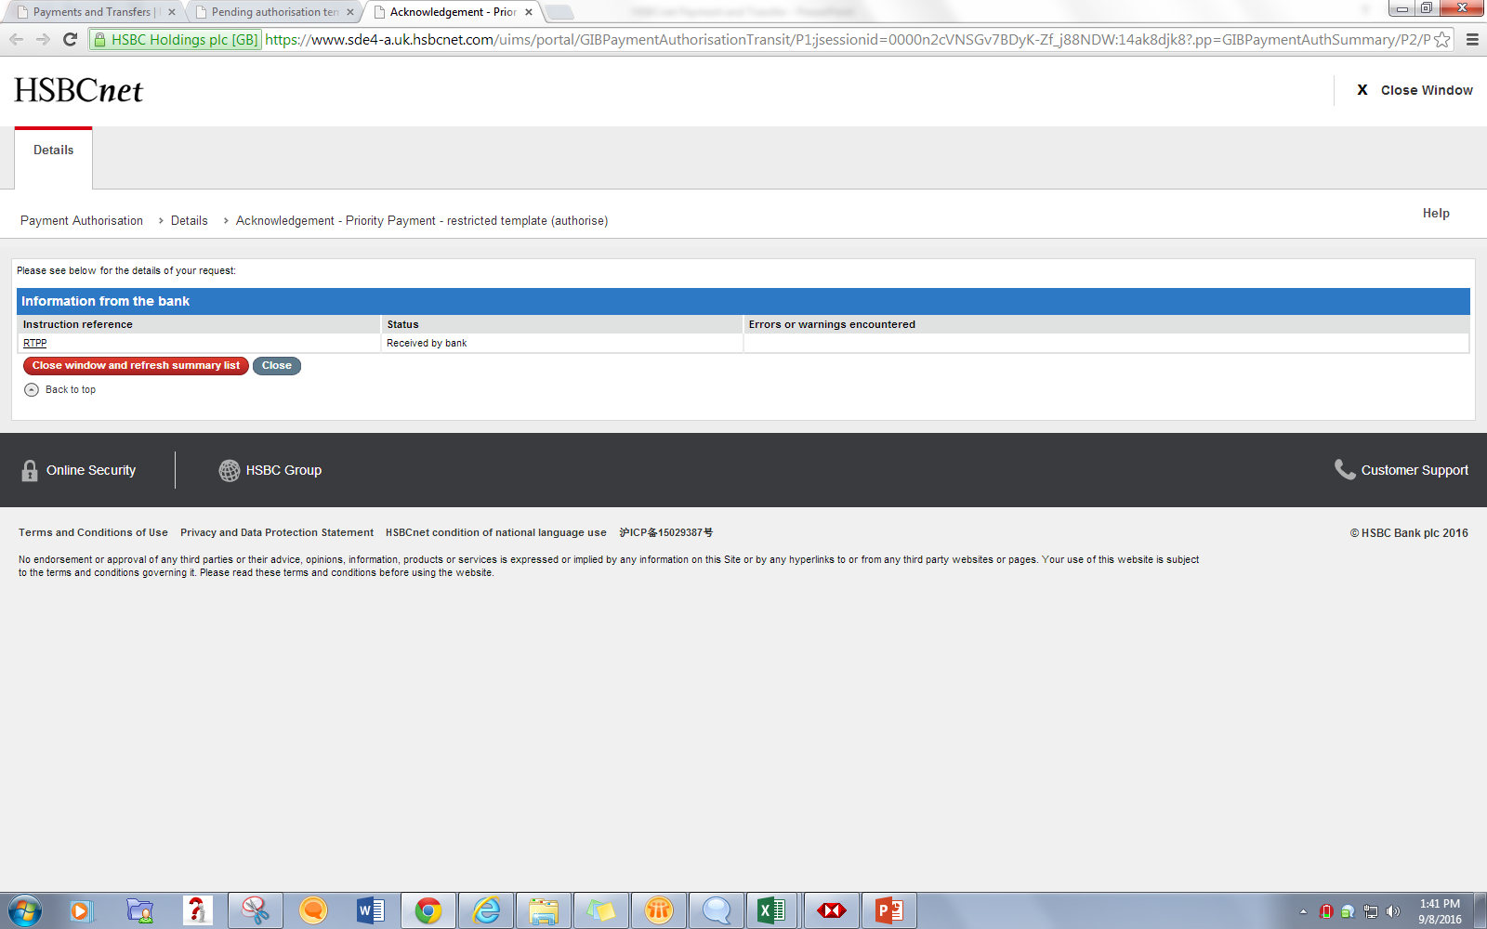

Slide 50

Action 1 :Create Payment from Templates

Slide 51



Slide 52



Slide 53


Slide 54

Action 2 : Create as New Template

Slide 55



Slide 56



Slide 57

Action 3 : Change Template

Slide 58



Slide 59



Slide 60

Action 4 : Delete Template

Slide 61



Slide 62


Slide 63
THANK YOU

